Slide 1
Algorithms

Slide 2
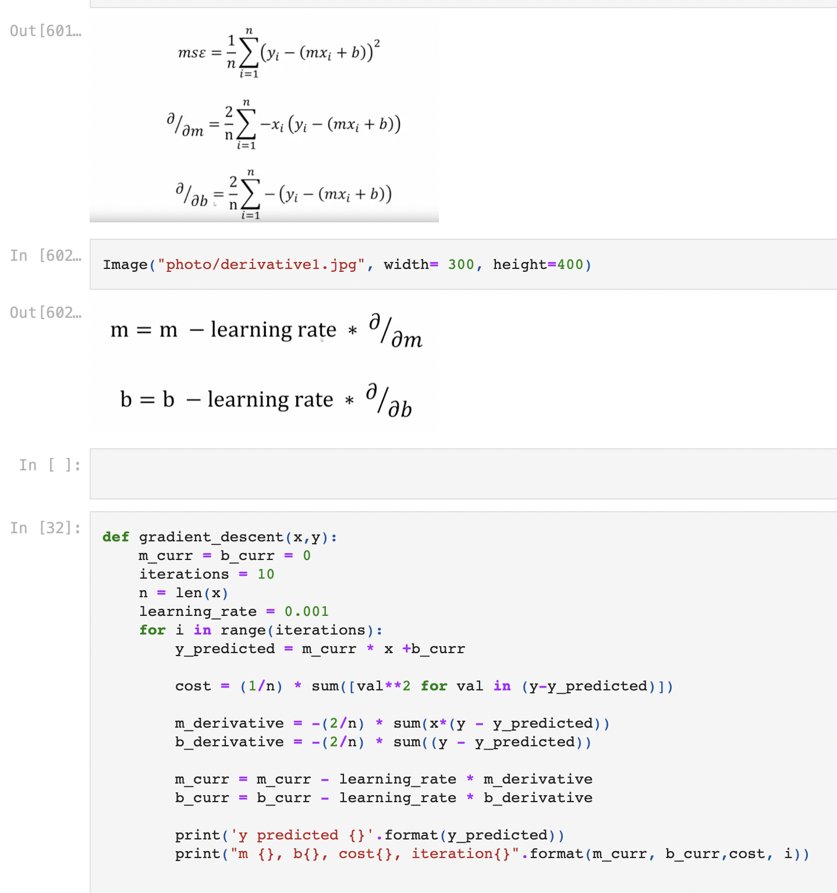
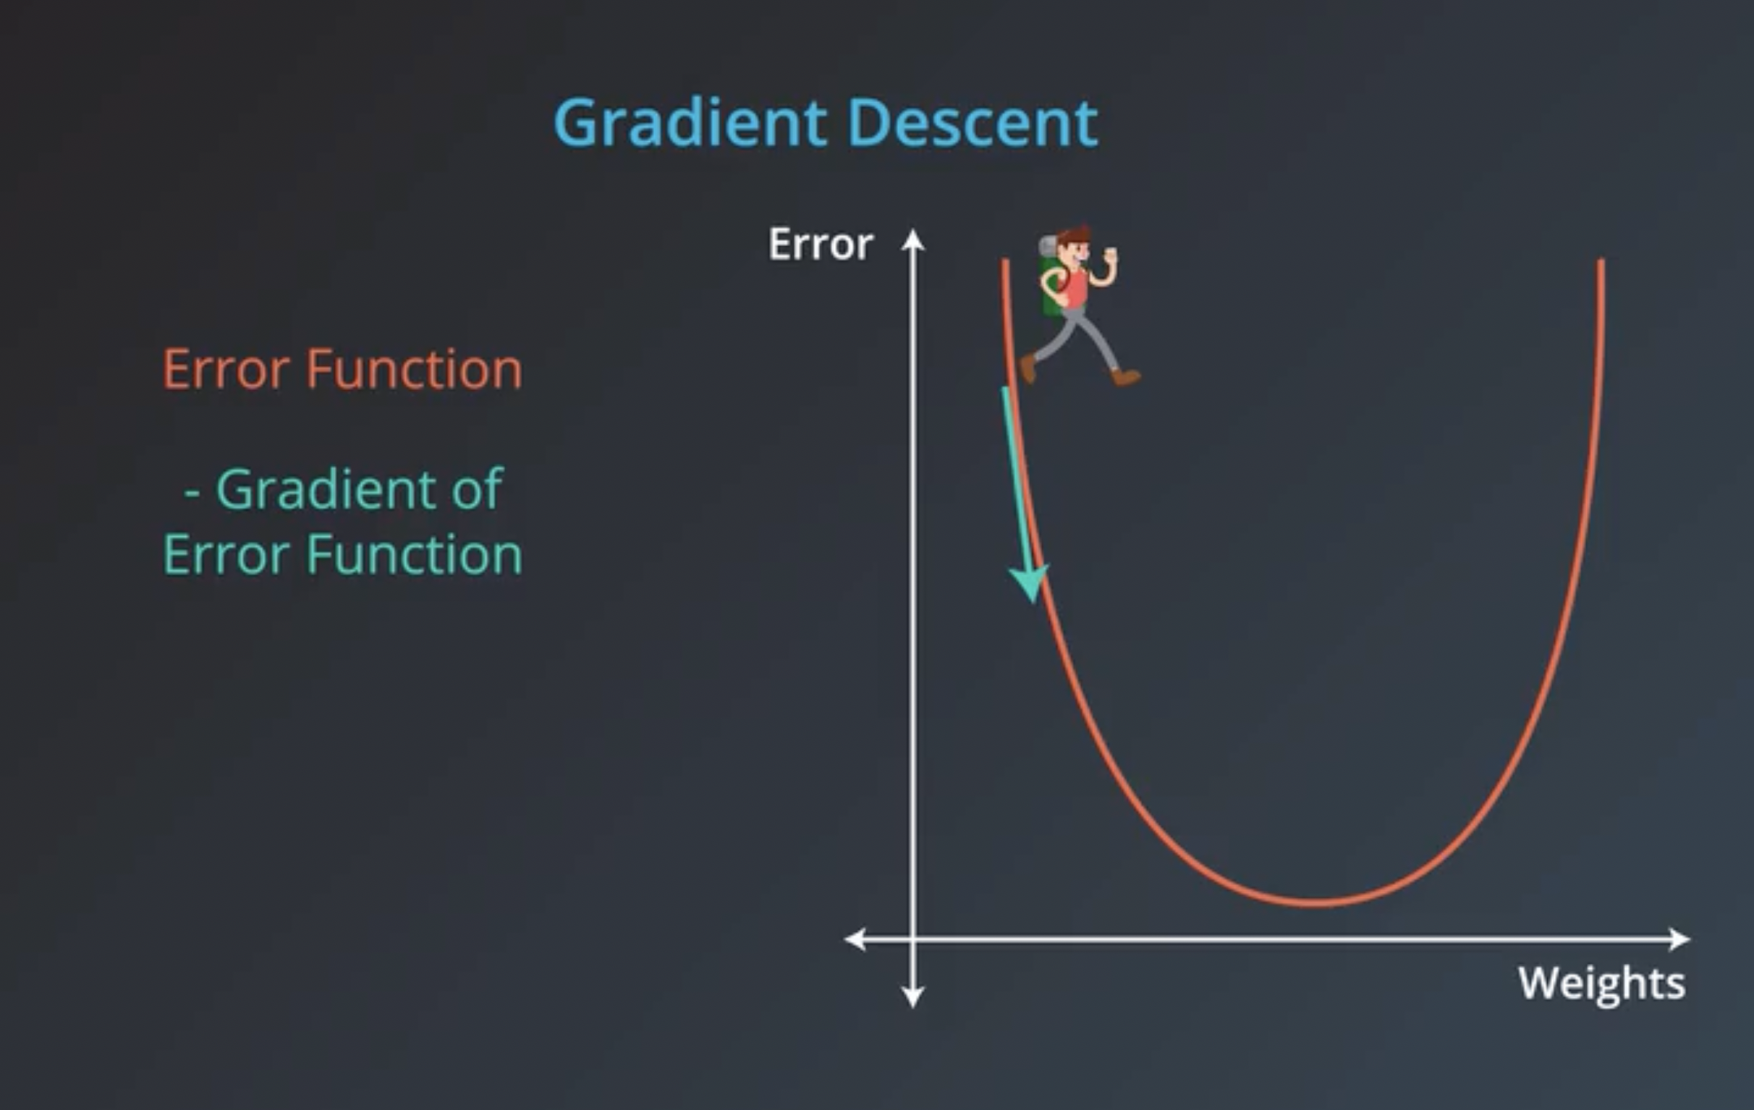
Linear regression
Notes:
Our goal is to minimize this error to obtain the most accurate value of weights
Mean squared error (MSE)
A gradient measures how much the output of a function changes if you change the inputs a little bit." — Lex Fridman
A gradient simply measures the change in all weights with regard to the change in error. You can also think of a gradient as the slope of a function. The higher the gradient, the steeper the slope and the faster a model can learn. But if the slope is zero, the model stops learning. In mathematical terms, a gradient is a partial derivative with respect to its inputs.
https://builtin.com/data-science/gradient-descent

Slide 3
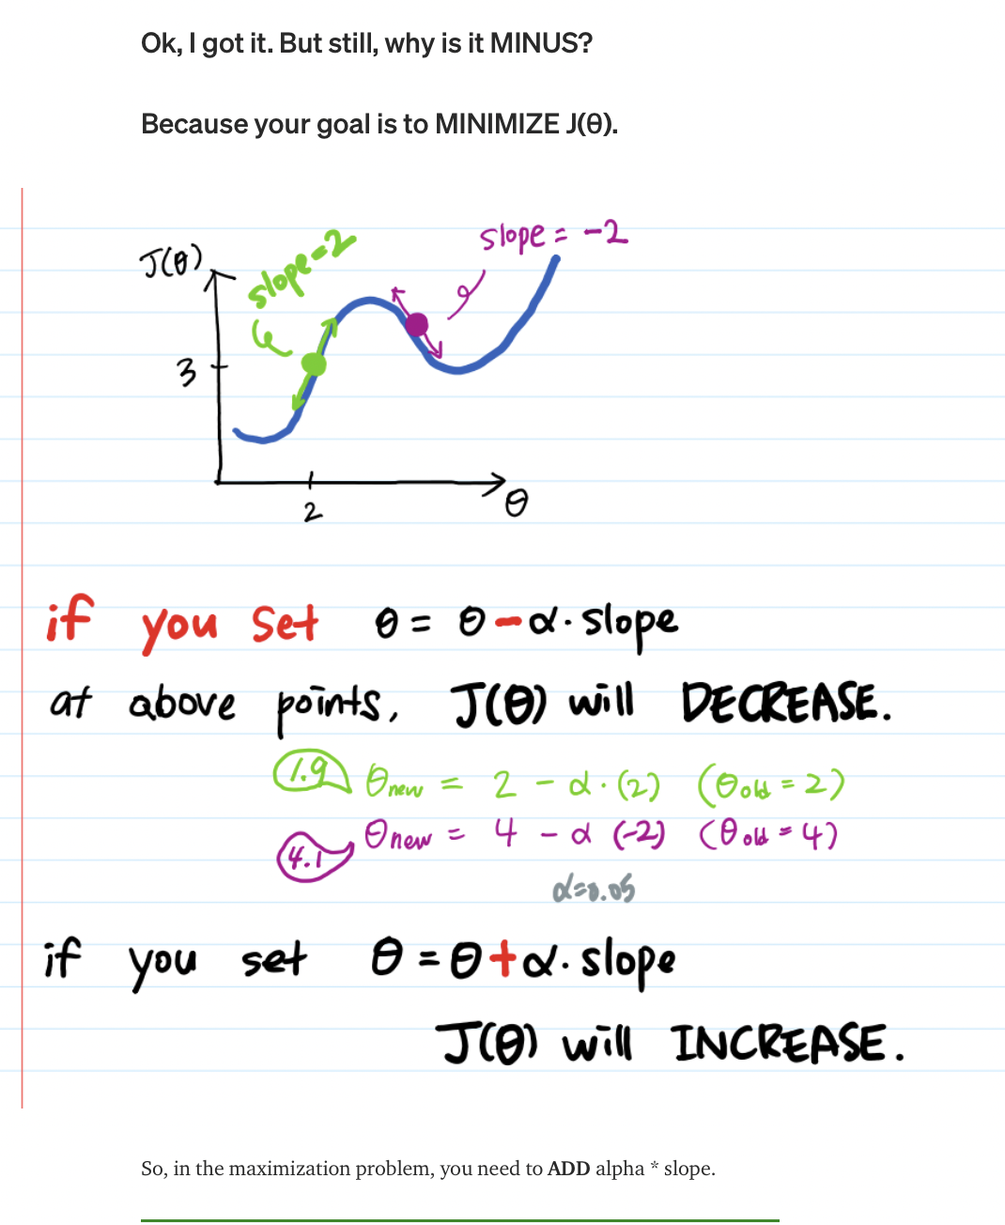
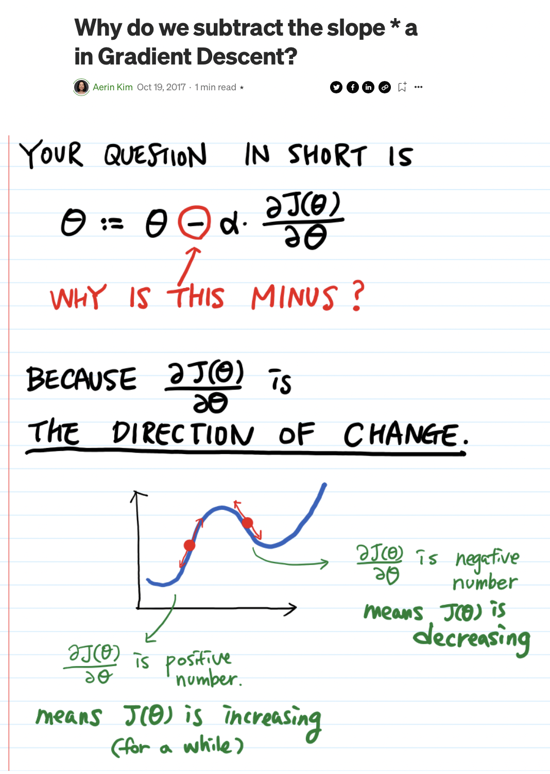
Why substract?
Notes:
https://automata88.medium.com/why-do-we-subtract-the-slope-a-in-gradient-descent-73c7368644fa

Slide 4
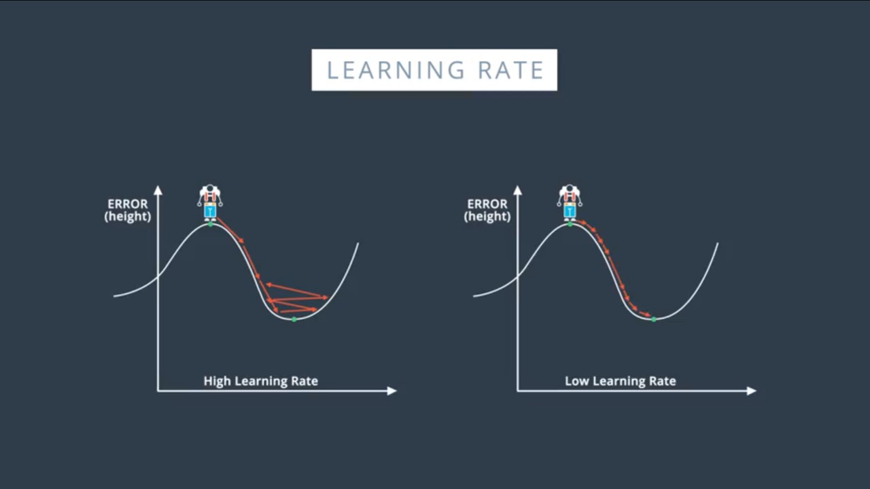
Learning Rate
Learning Rate
More time to reach local/global minima
Learning Rate
Might not reach to minima
Good starting point : 0.01

Slide 5
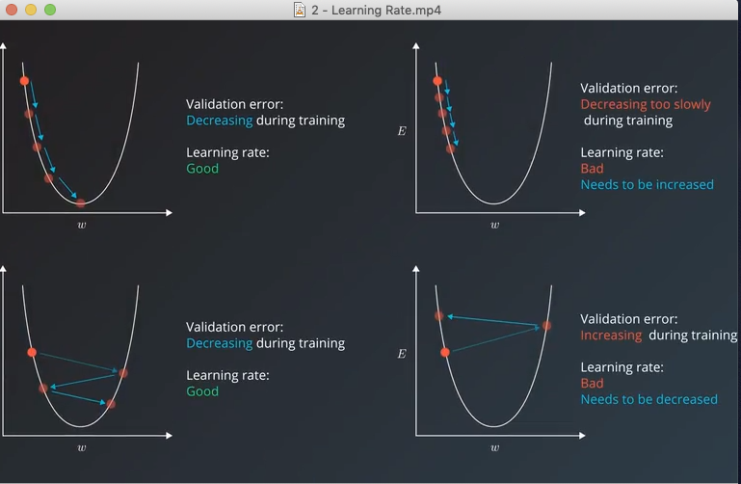
Learning Rate

Slide 6
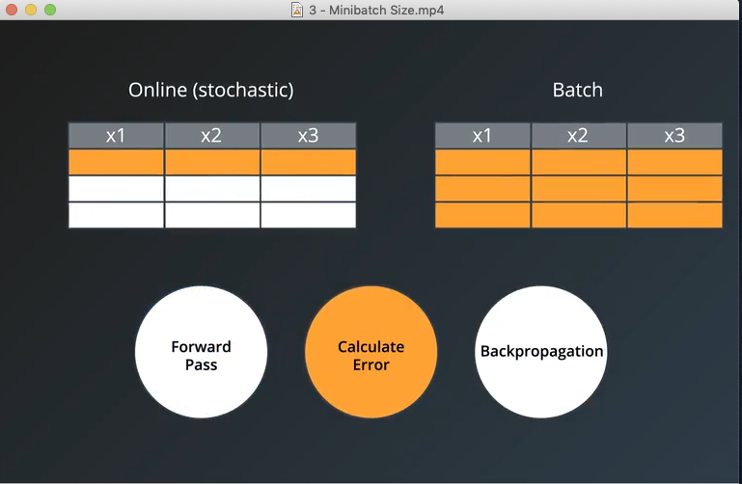
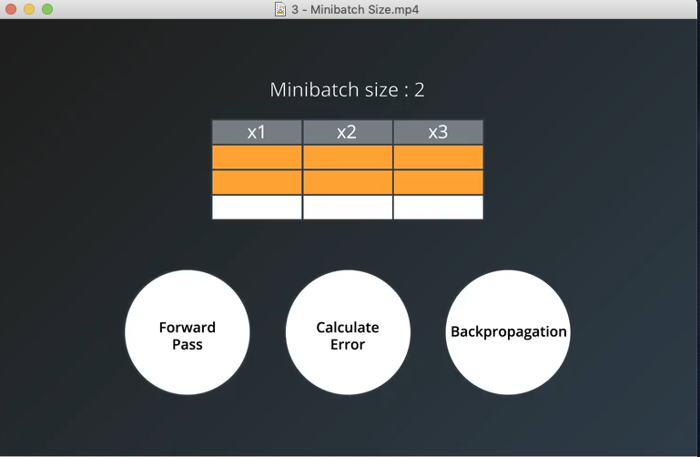
Batch

Slide 7
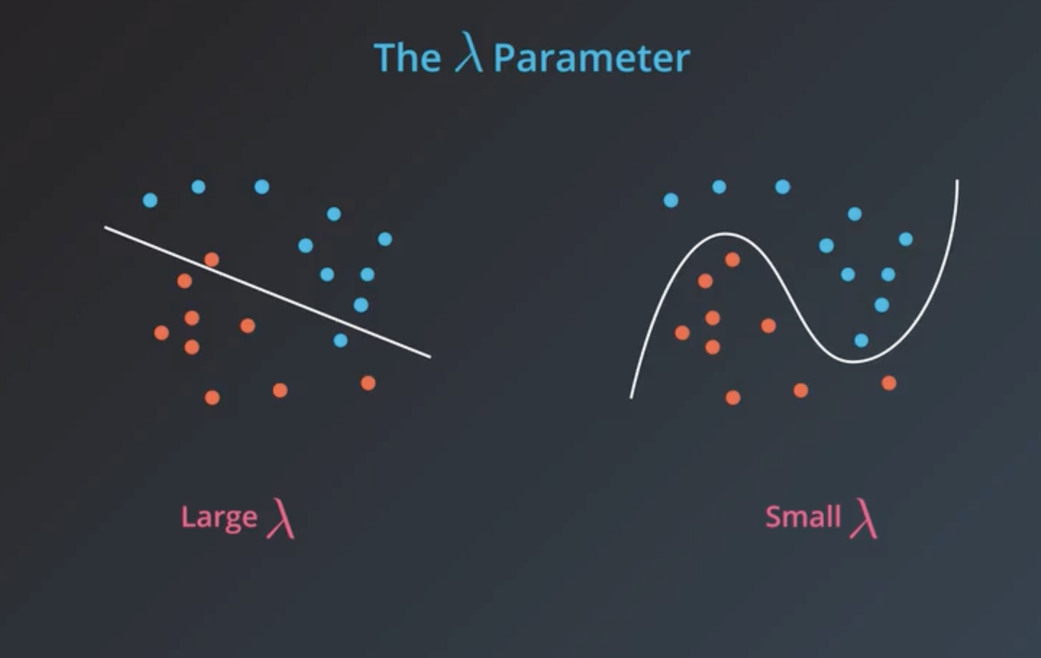
Regularization
Notes:
If we want simpler model, we choose large lambda, and penalize more-
If we want complex model, we choose small lambda, penalize less
L1- lasso
L2- ridge

Slide 8
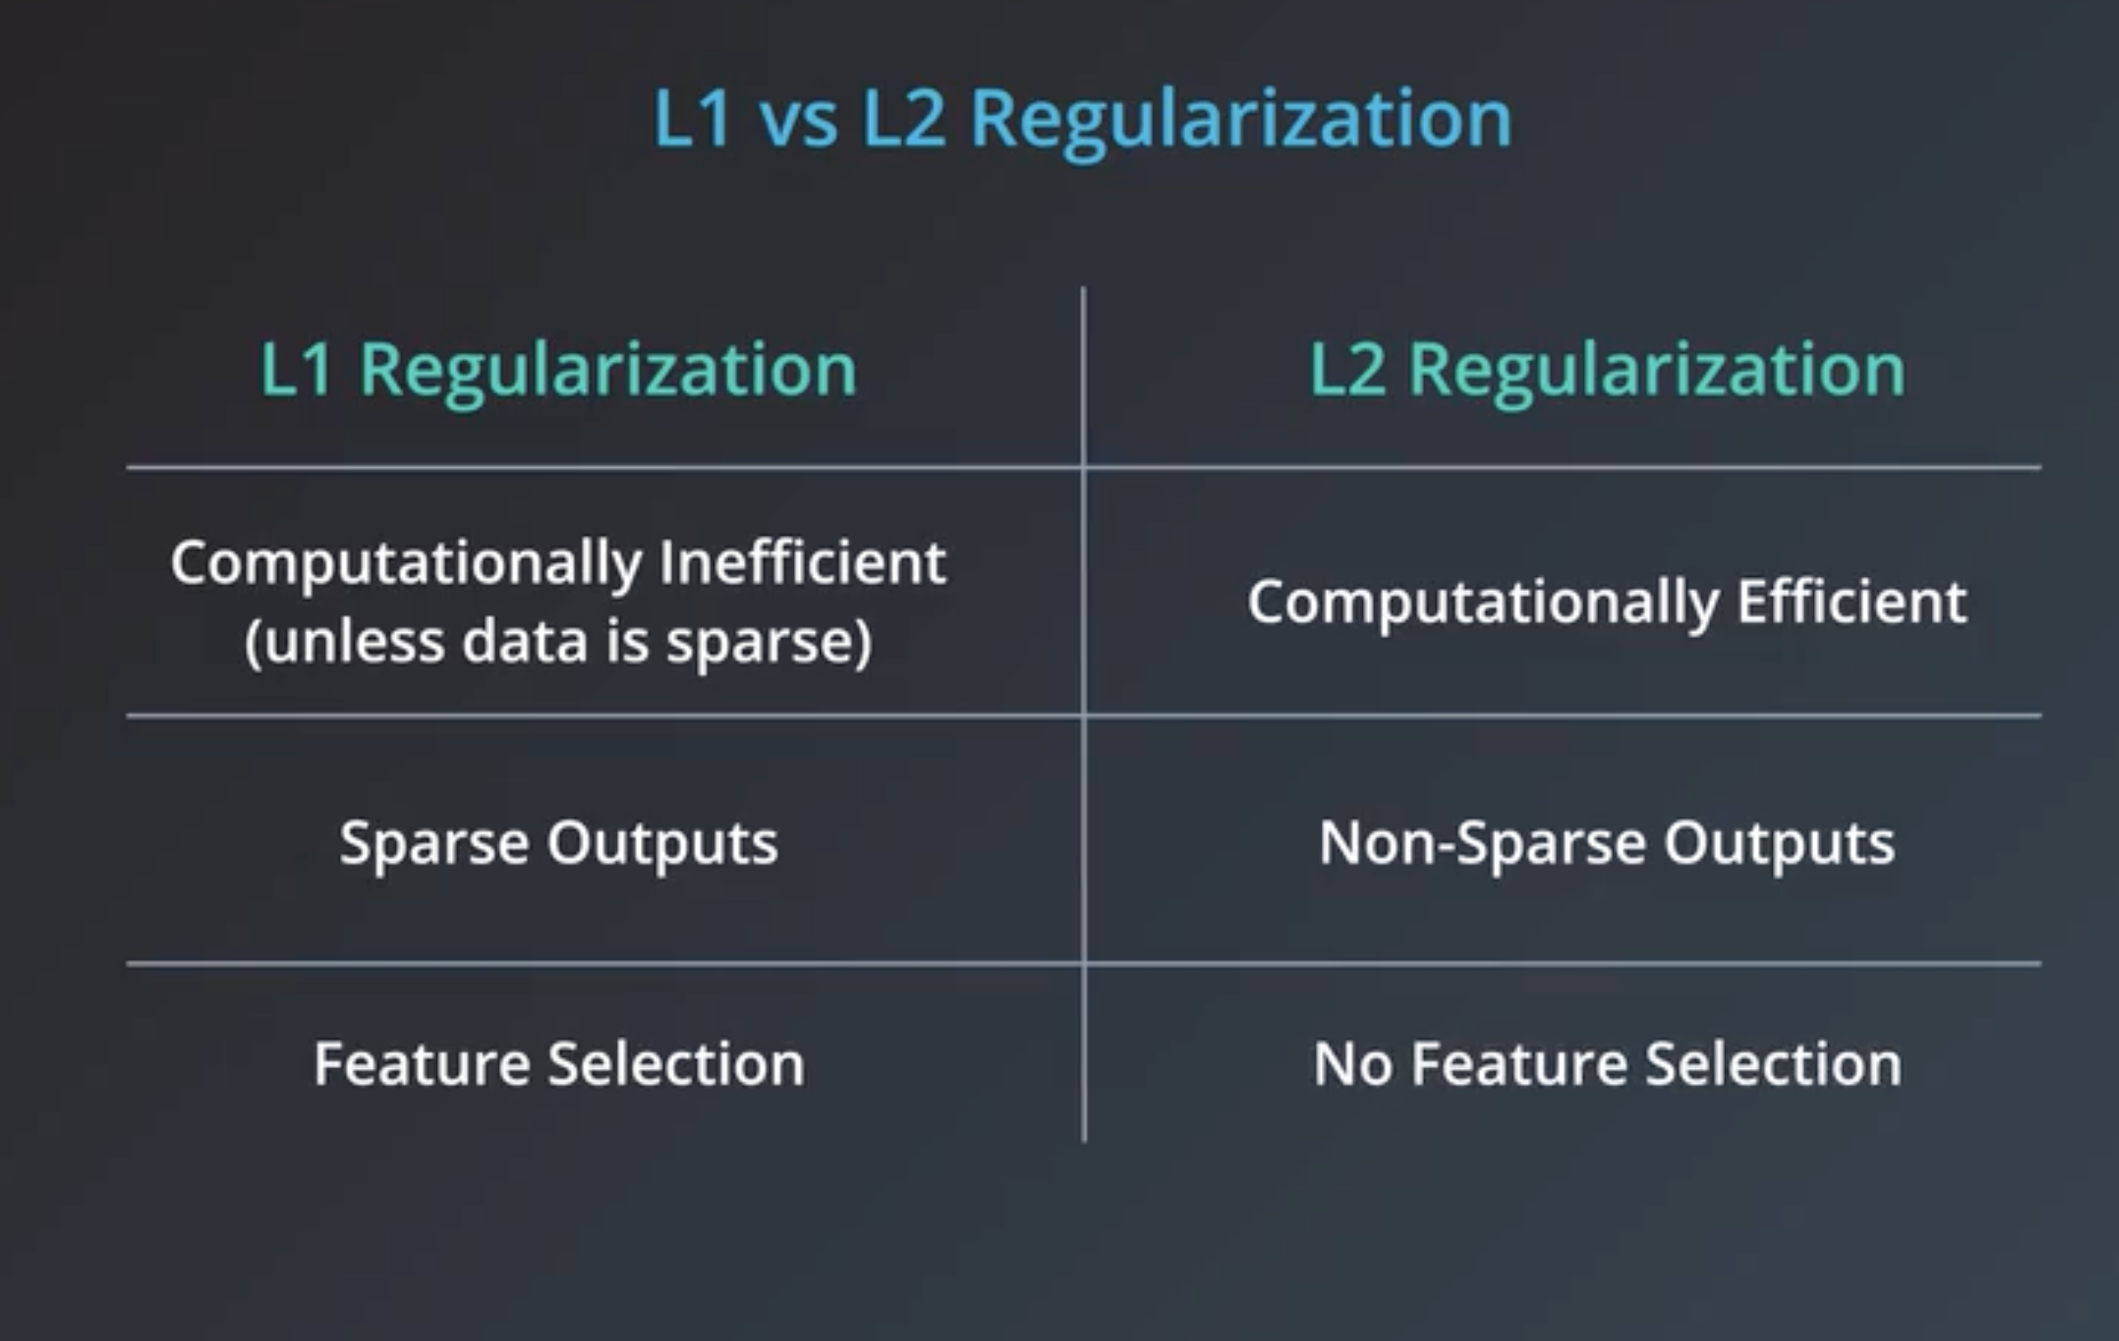

Slide 9
Logistic Regression

Slide 11
Naïve Bayes

Slide 13
Decision Tree
A decision tree is a machine learning model that builds upon iteratively asking questions to partition data and reach a solution.

Slide 14
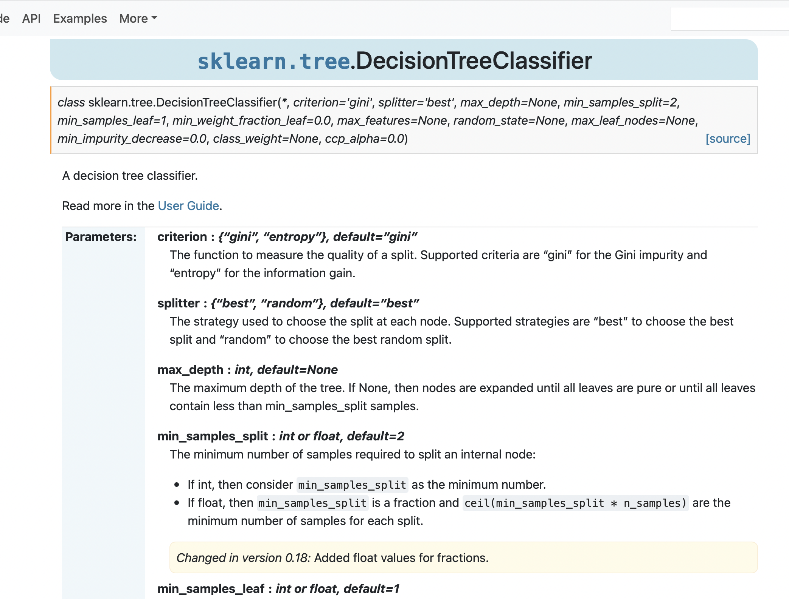

Slide 15
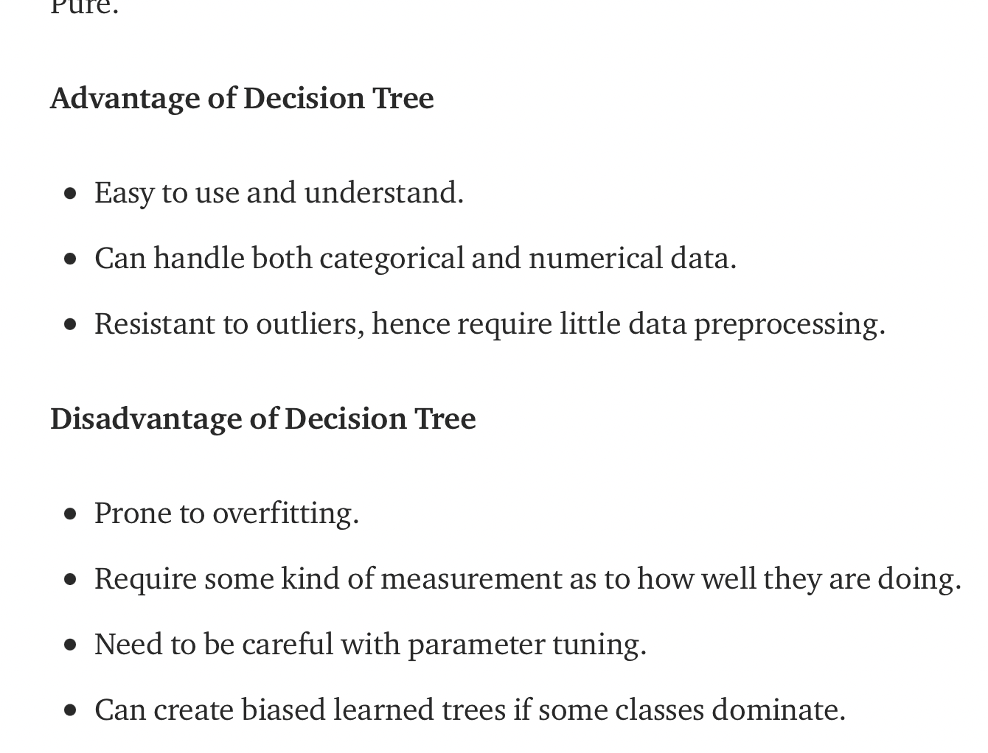
Decision Tree
Notes:
https://towardsdatascience.com/decision-tree-in-machine-learning-e380942a4c96

Slide 16
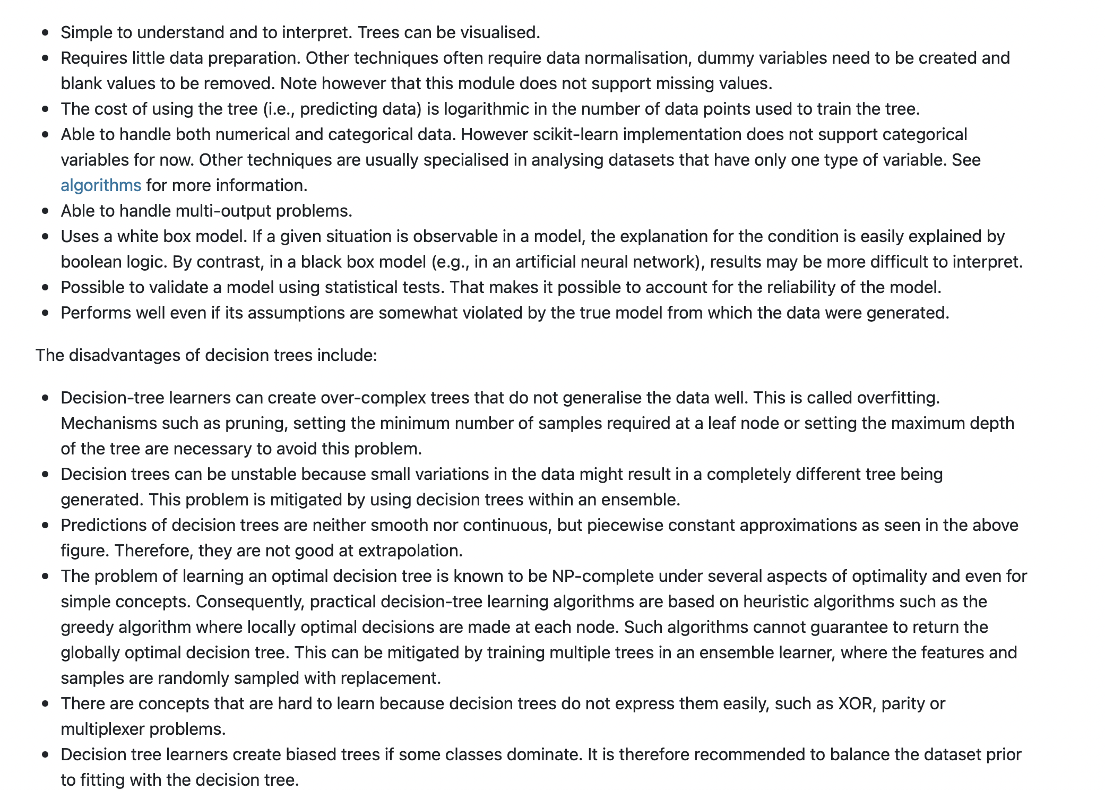
Decision Tree
Notes:
https://scikit-learn.org/stable/modules/tree.html

Slide 17
Decision Tree
Notes:
https://scikit-learn.org/stable/modules/tree.html

Slide 18
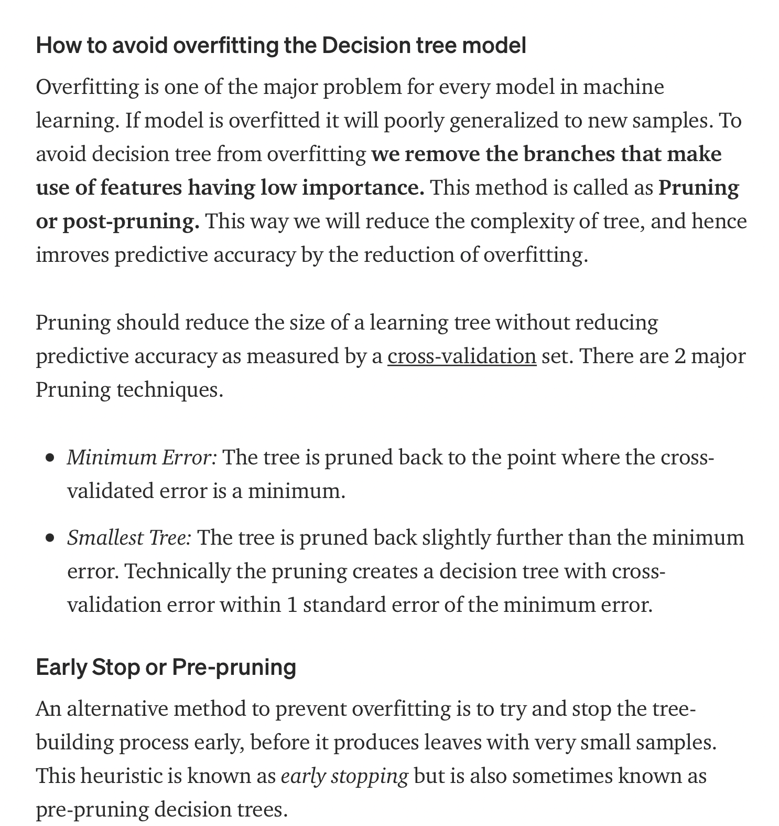
Decision Tree
Notes:
https://towardsdatascience.com/decision-tree-in-machine-learning-e380942a4c96

Slide 20
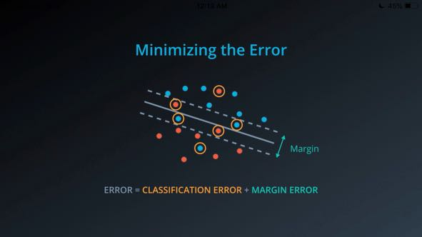
SVM

Slide 21
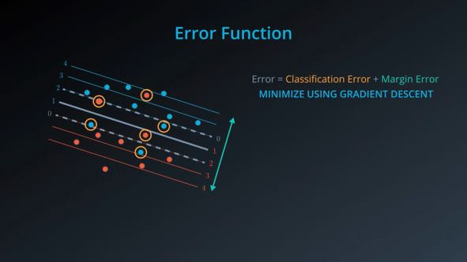

Slide 22
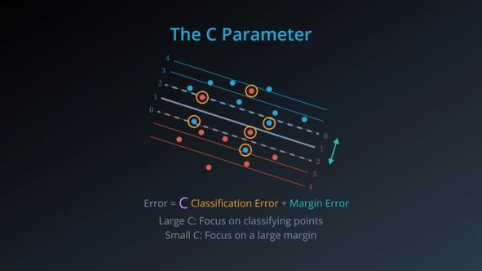

Slide 23
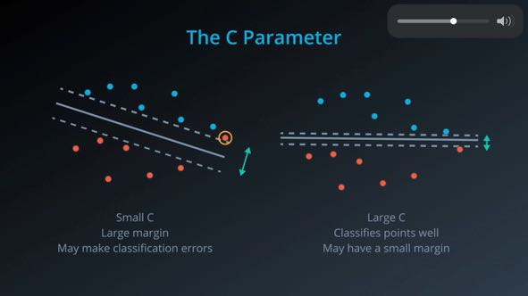

Slide 24
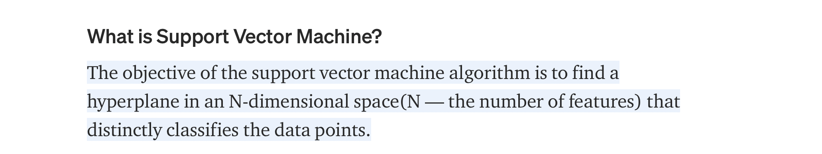
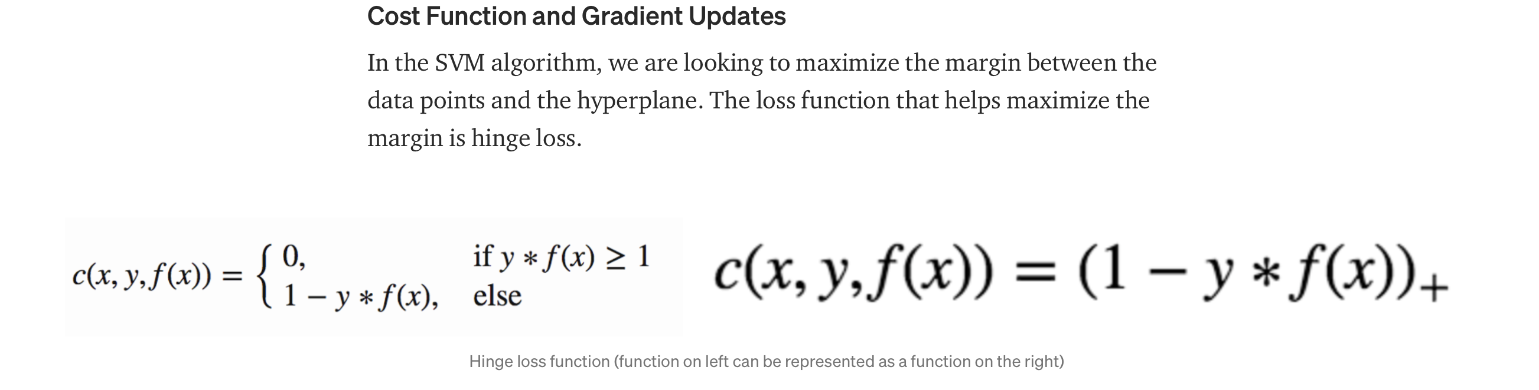
Notes:
https://towardsdatascience.com/support-vector-machine-introduction-to-machine-learning-algorithms-934a444fca47

Slide 25
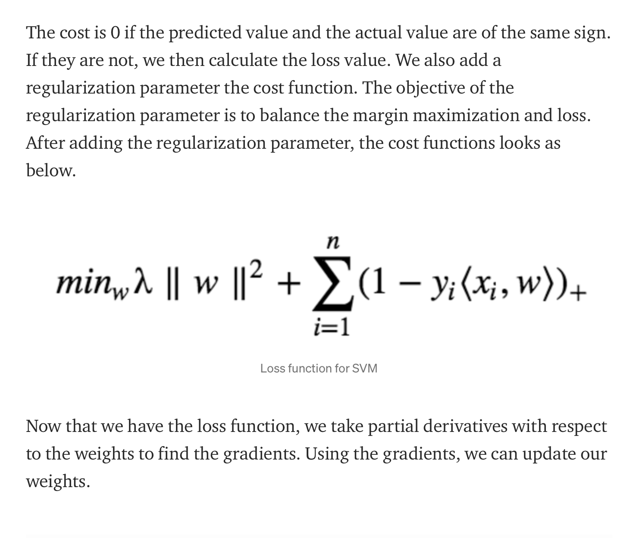

Slide 26
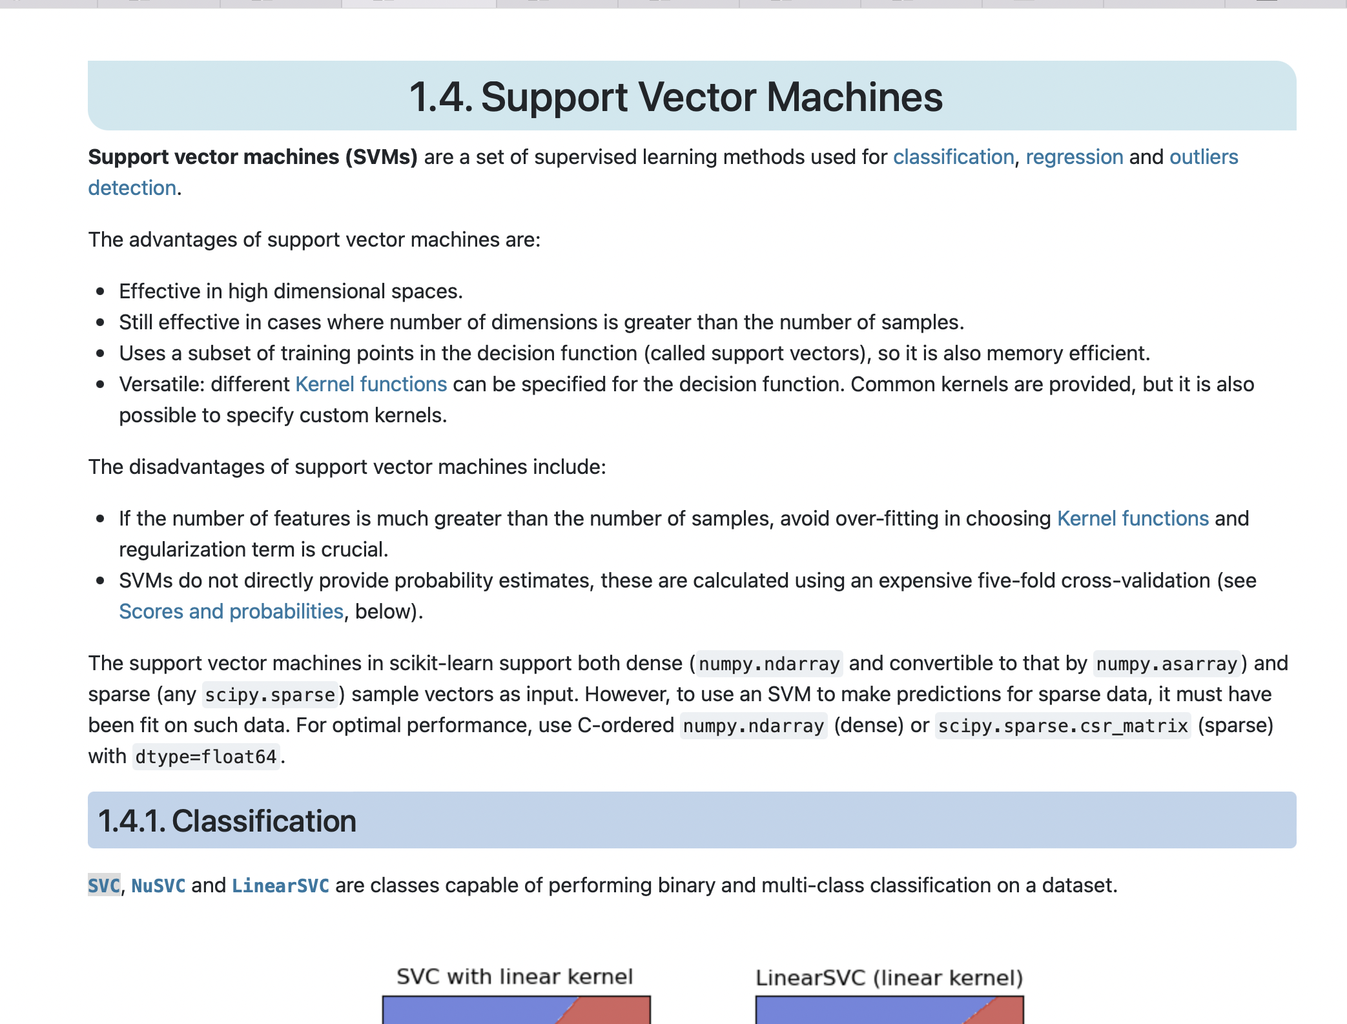
Notes:
https://scikit-learn.org/stable/modules/generated/sklearn.svm.SVC.html#sklearn.svm.SVC

Slide 27
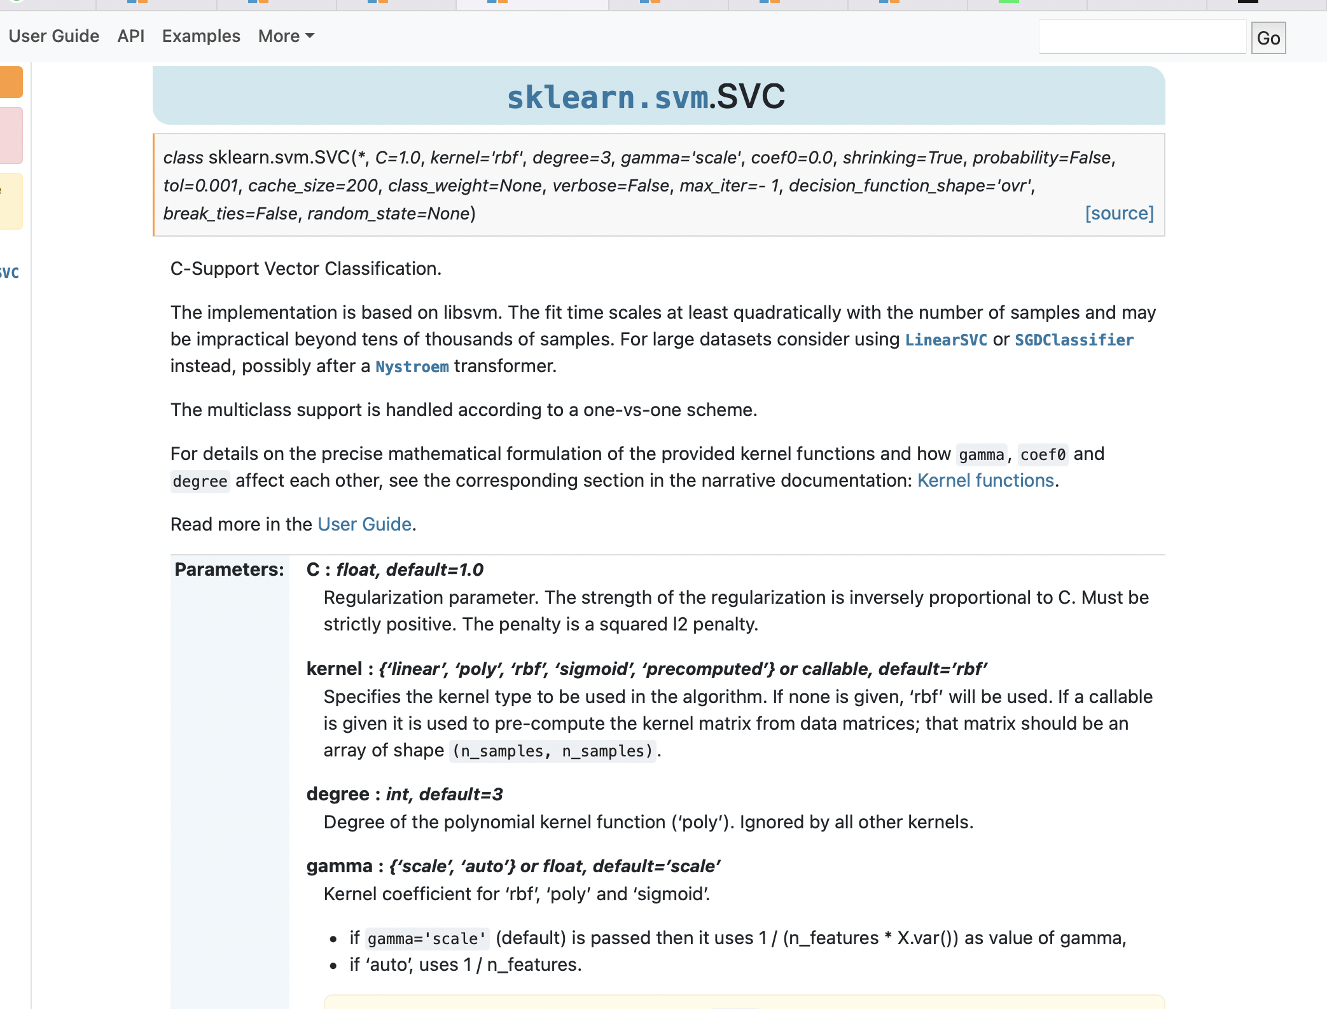
Notes:
Radial Basis Function (RBF)
Gamma is a hyperparameter in rbf

Slide 28
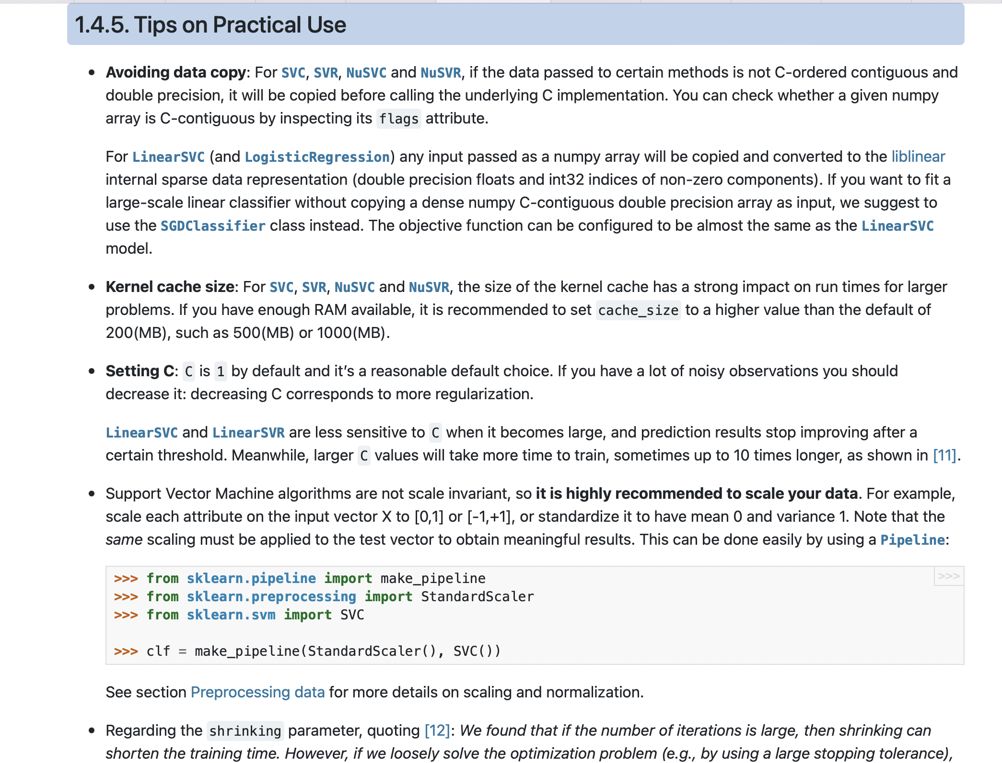

Slide 29
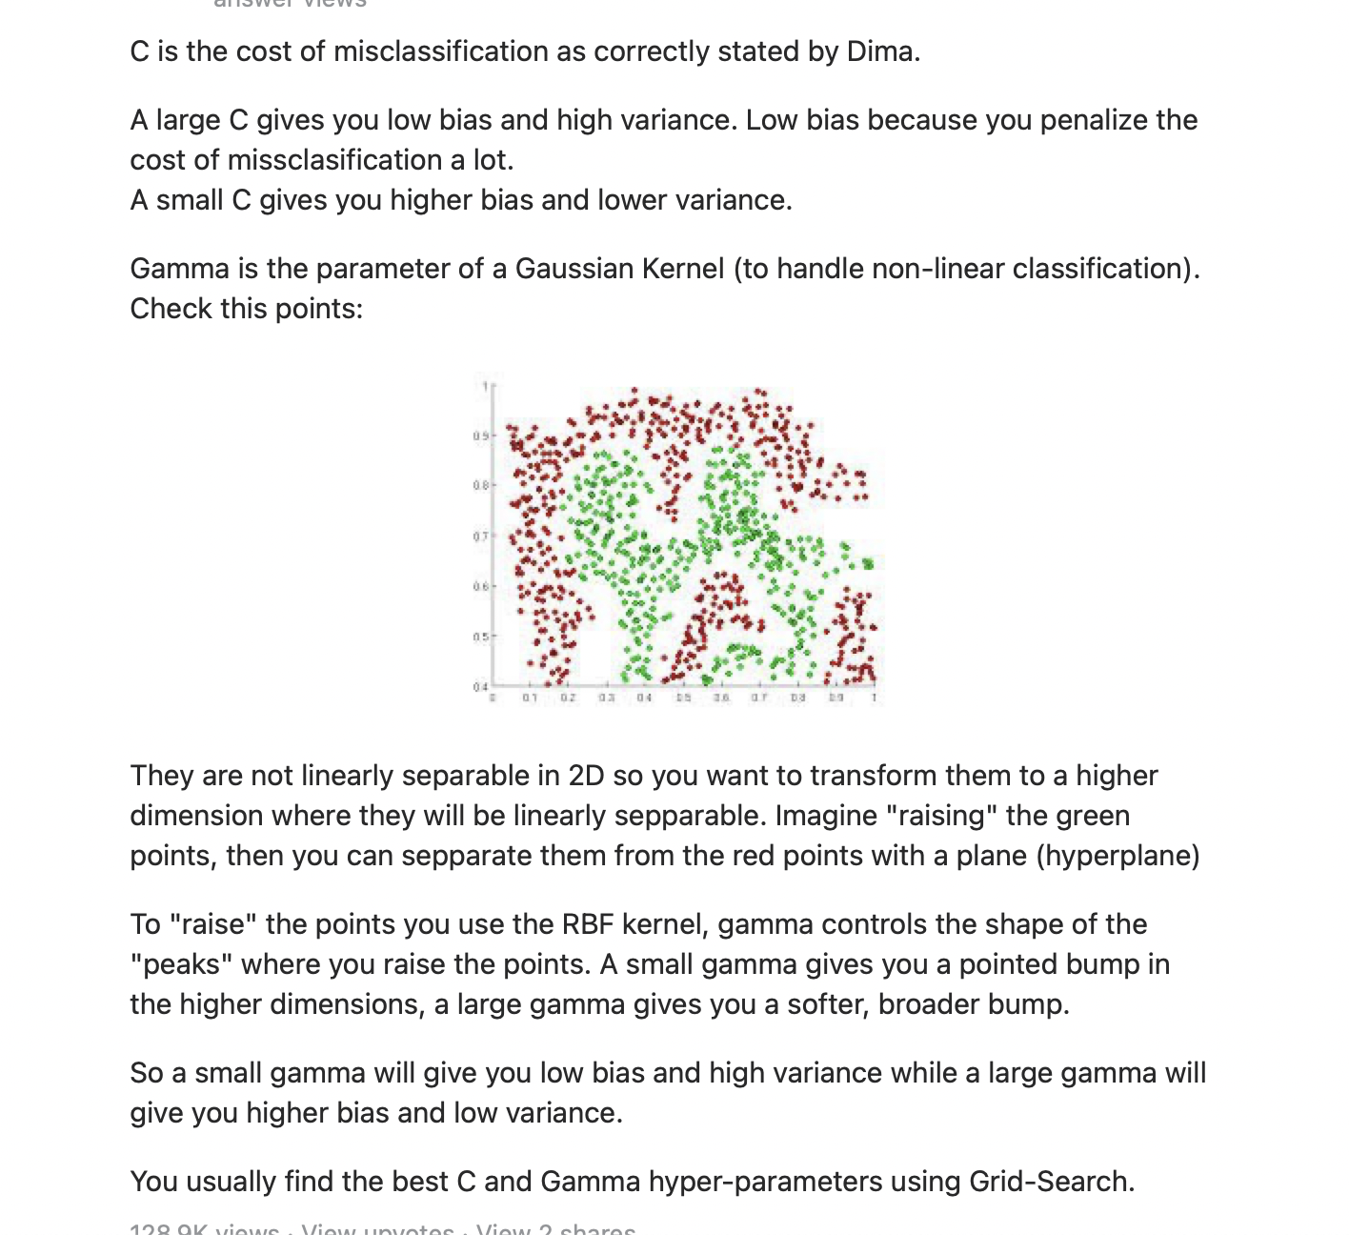

Slide 30
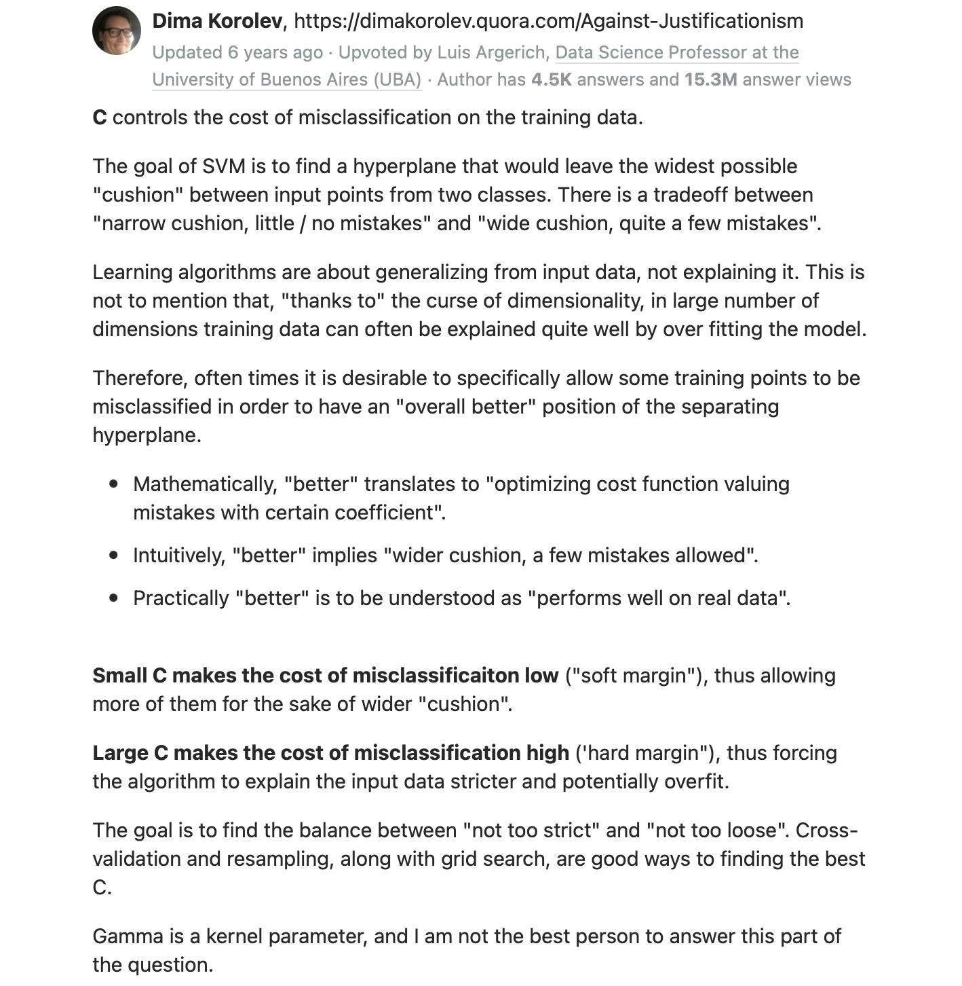

Slide 31
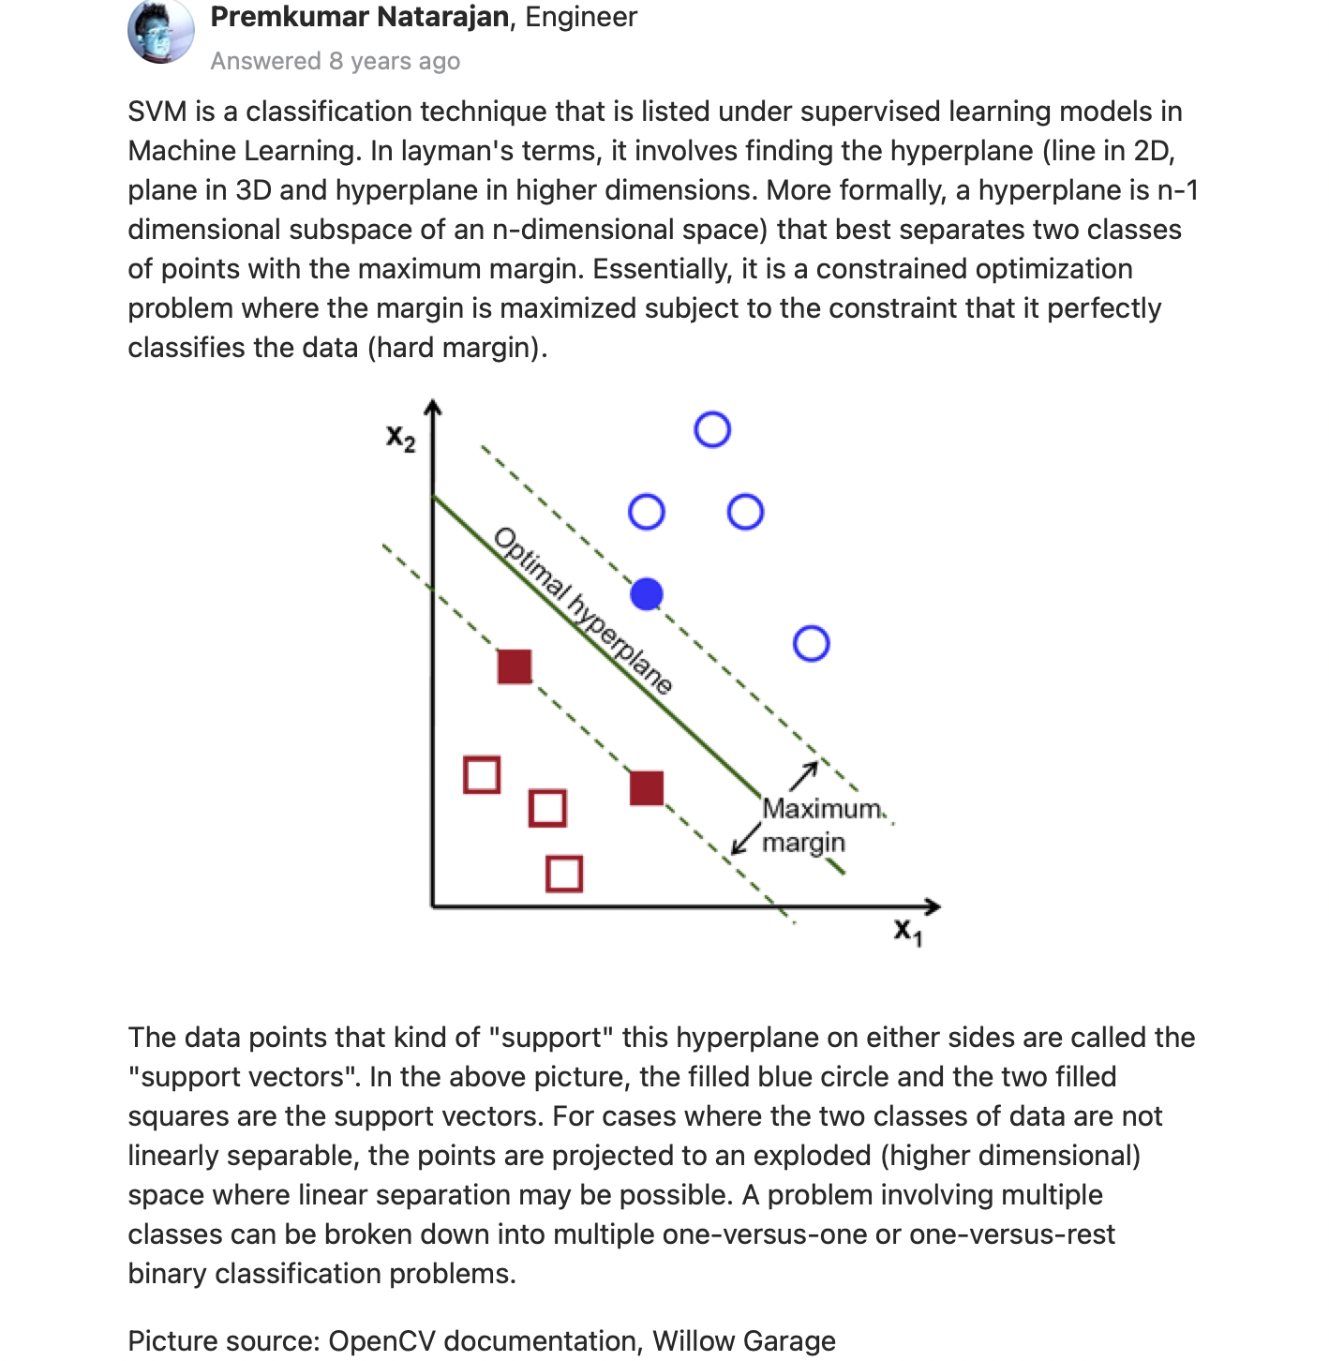

Slide 32
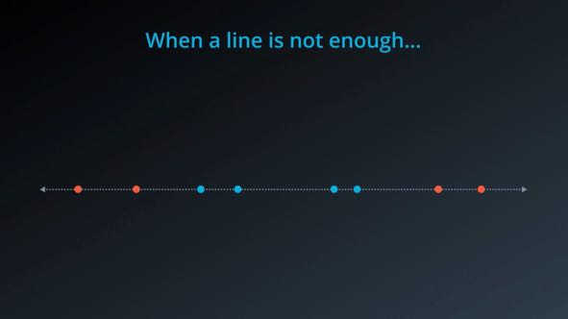
Kernel trick

Slide 33
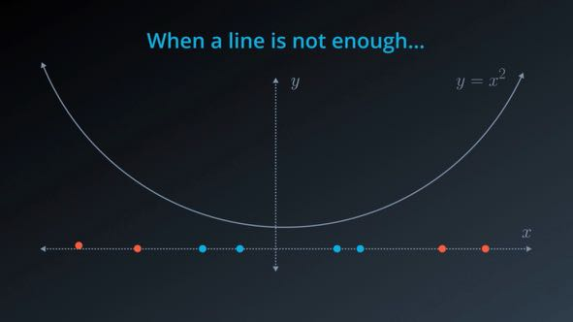

Slide 34
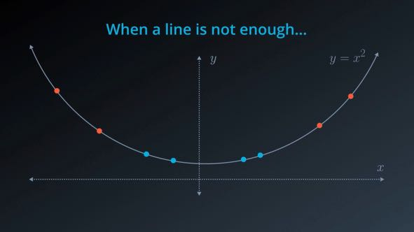

Slide 35
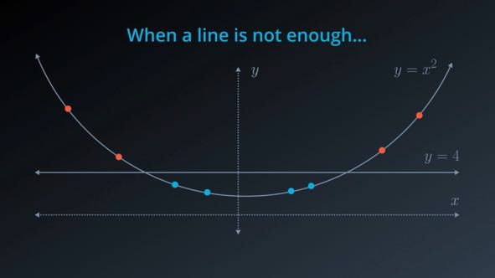

Slide 36
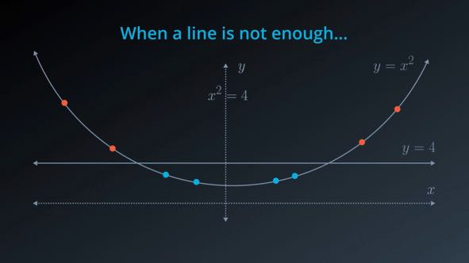

Slide 37


Slide 38
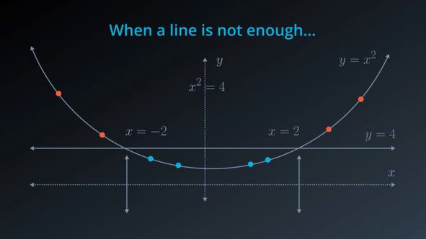

Slide 39
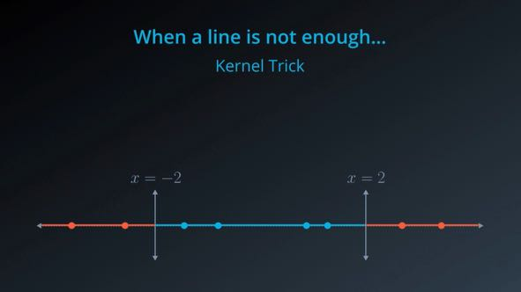

Slide 40
SVM
See stat_quest screenshot

Slide 41
Random forest
See statquest screenshot

Slide 42
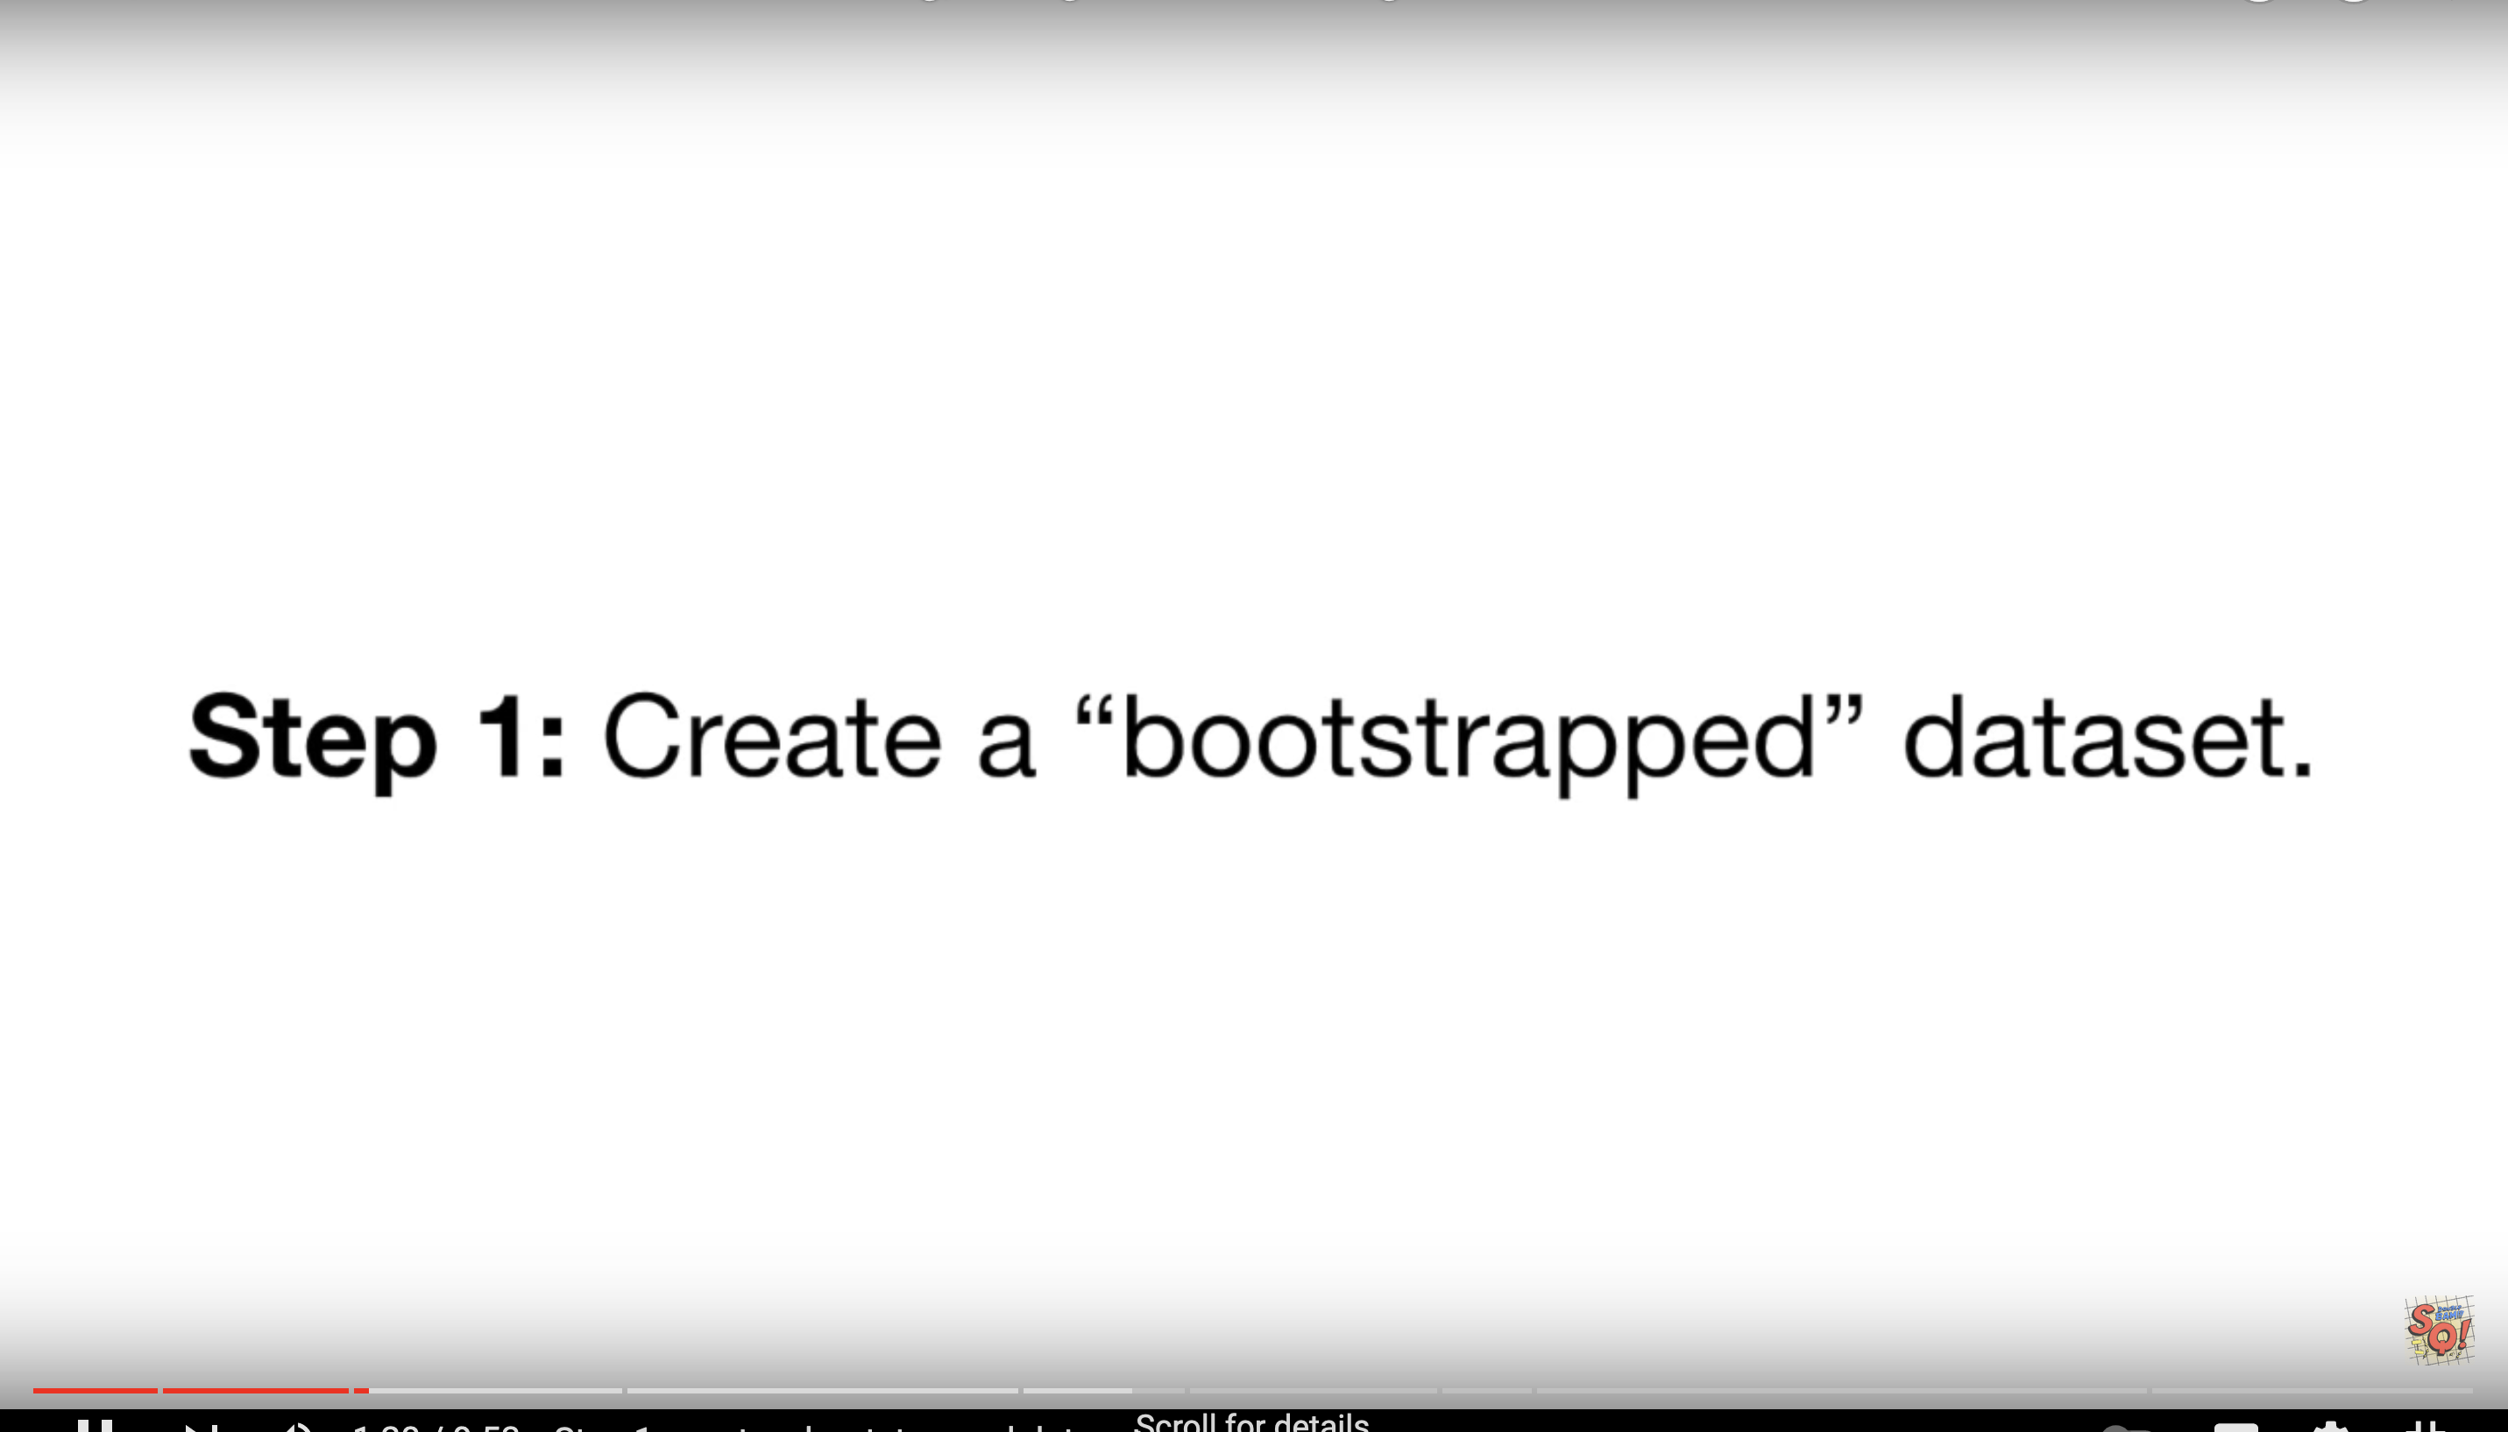

Slide 43
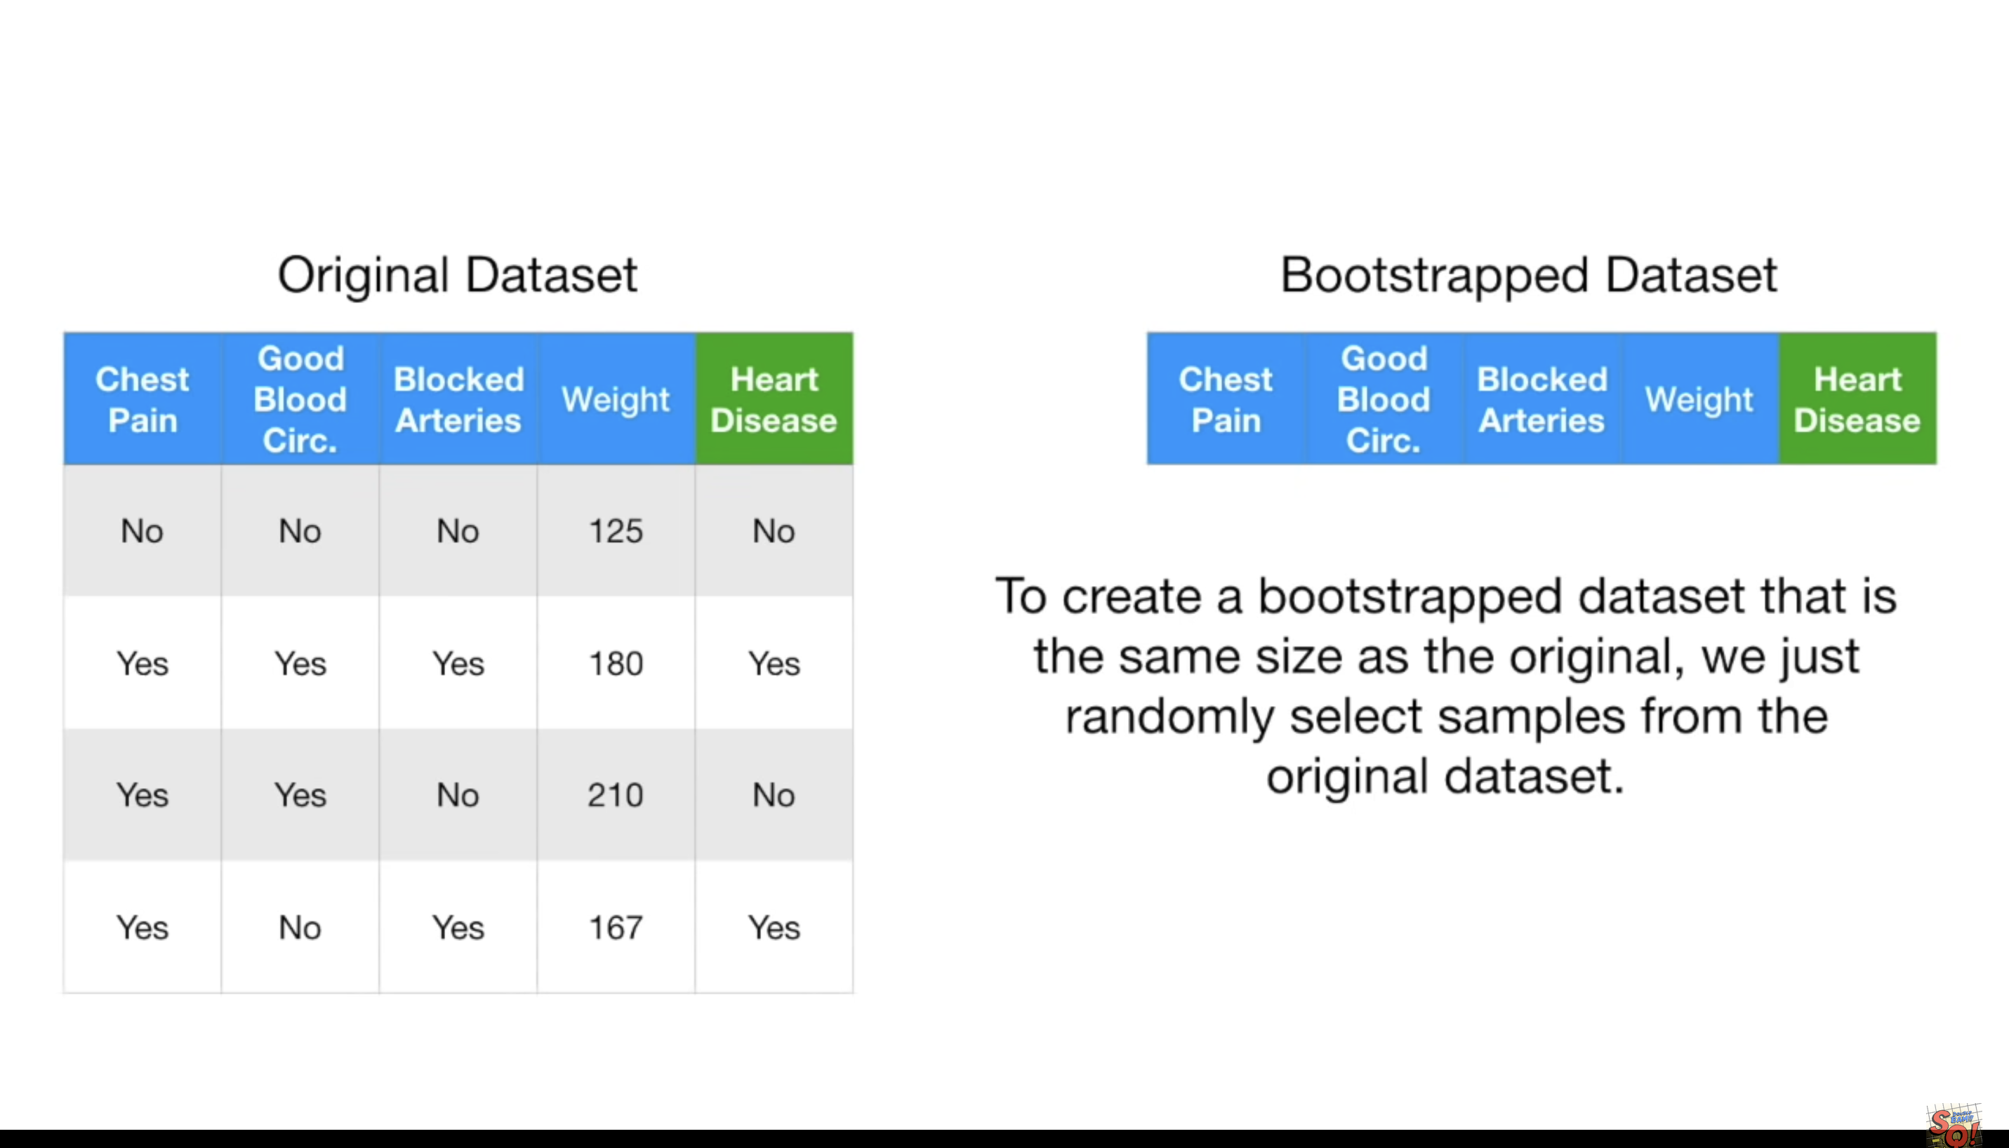

Slide 44
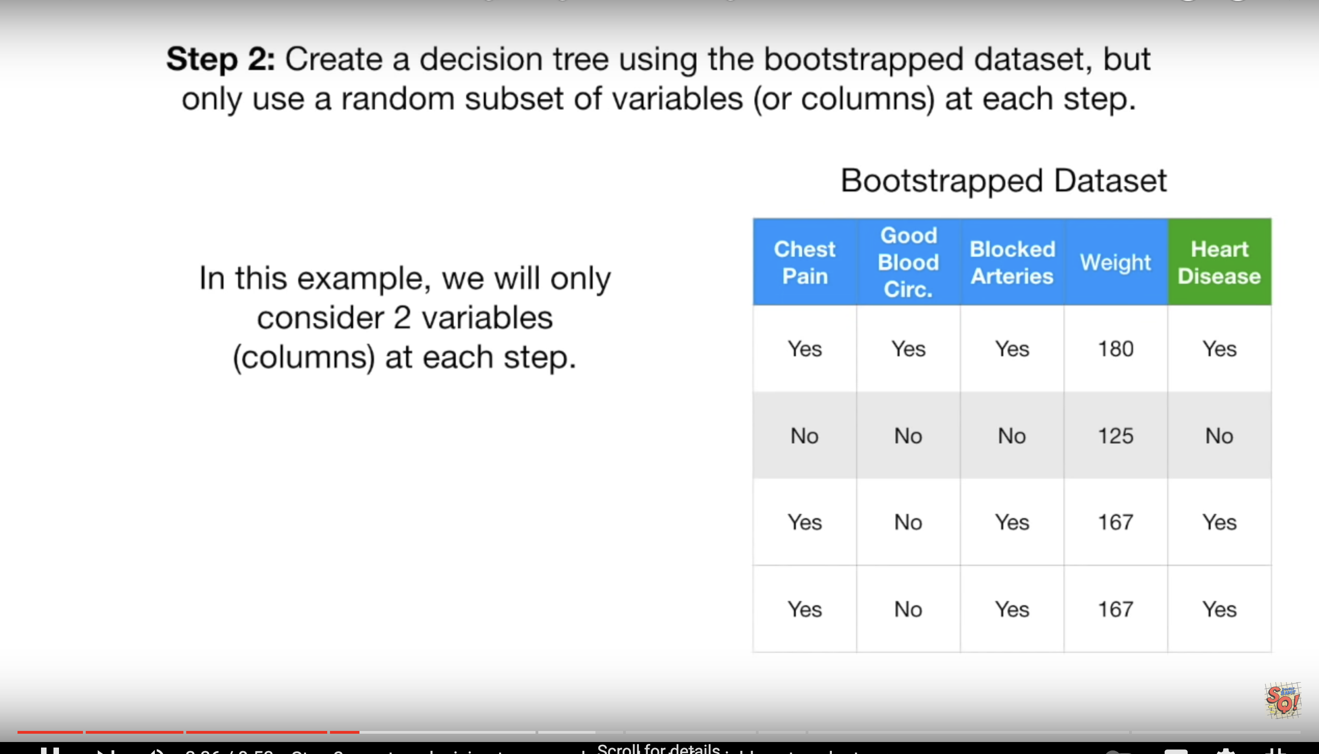

Slide 45
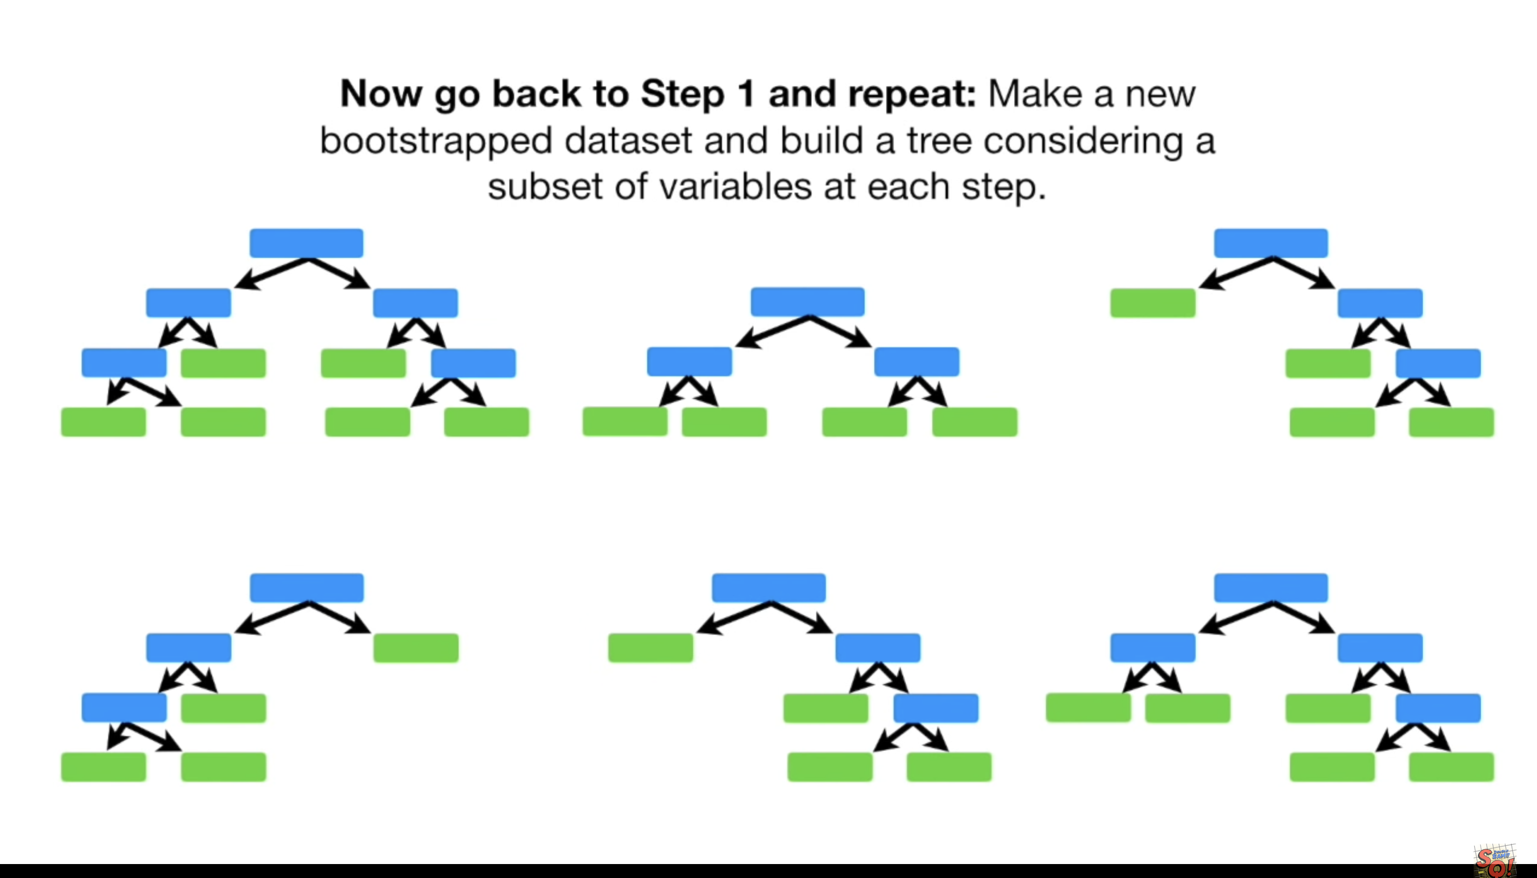

Slide 46
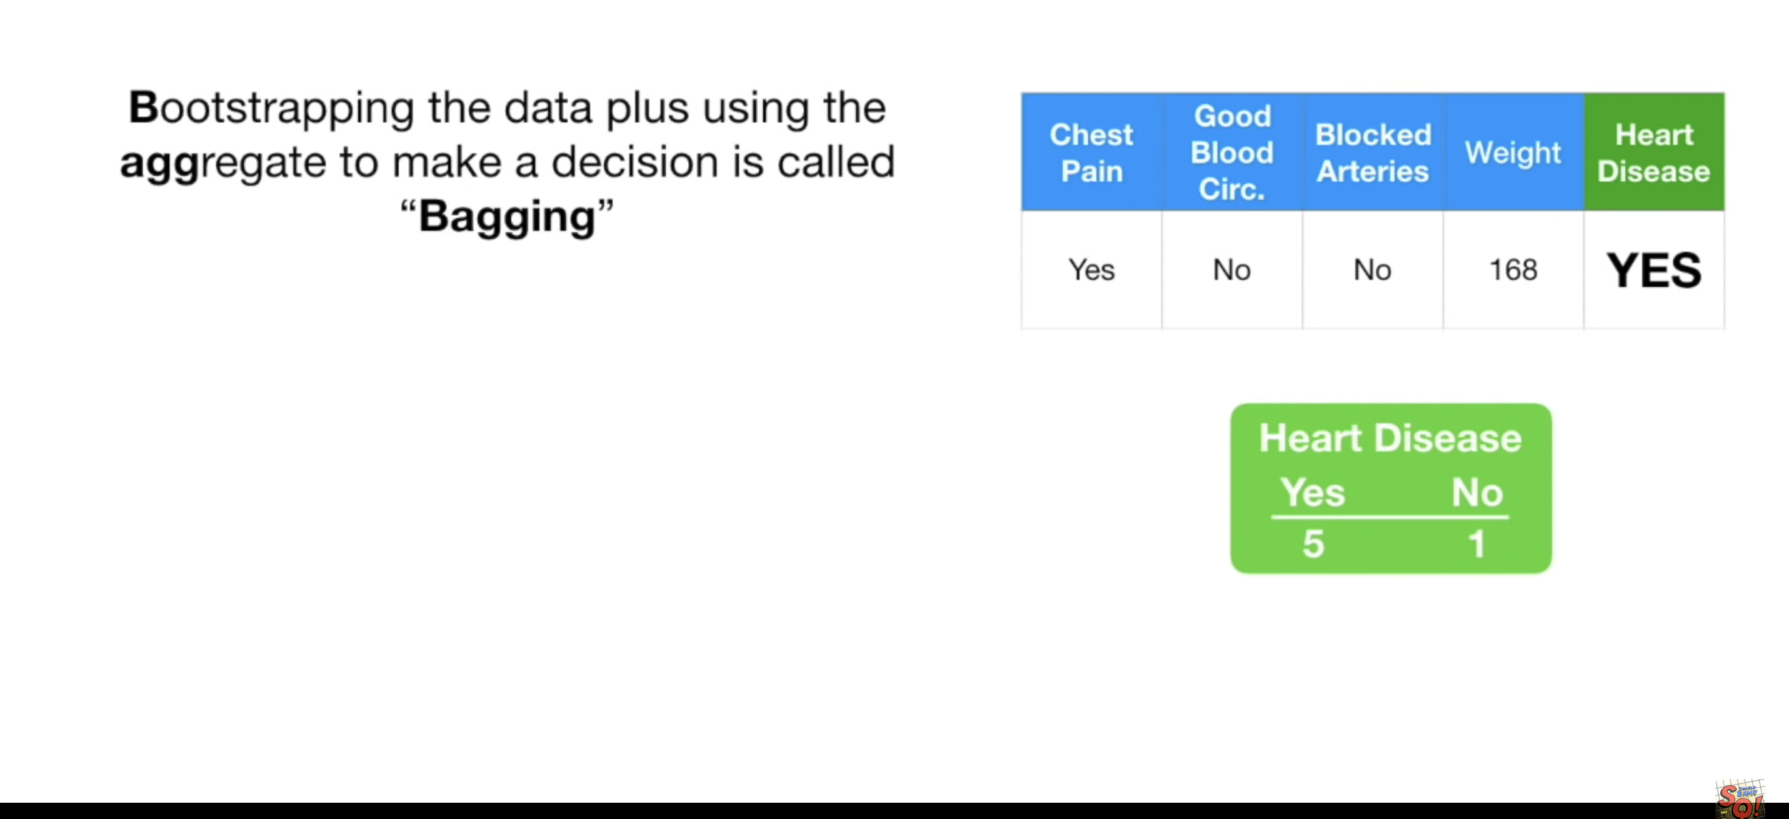

Slide 47
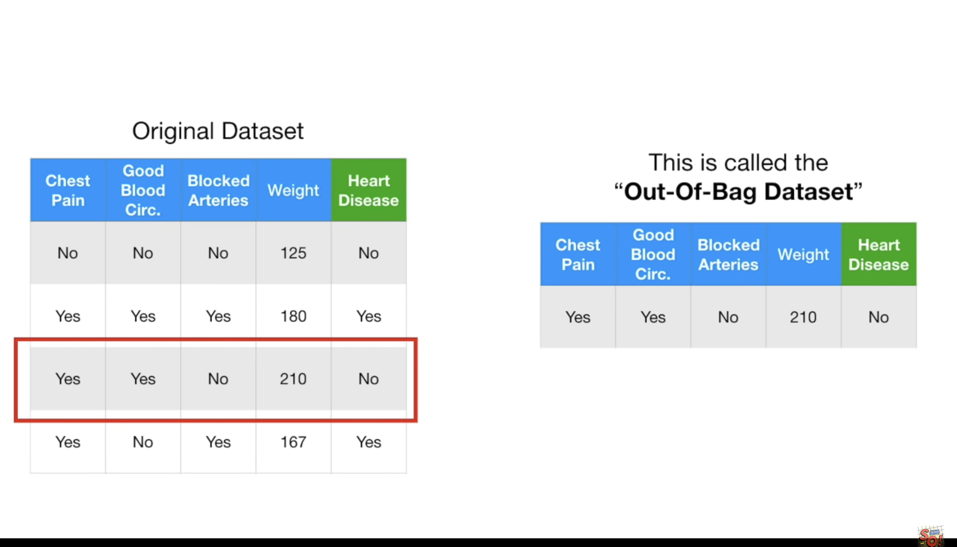

Slide 48
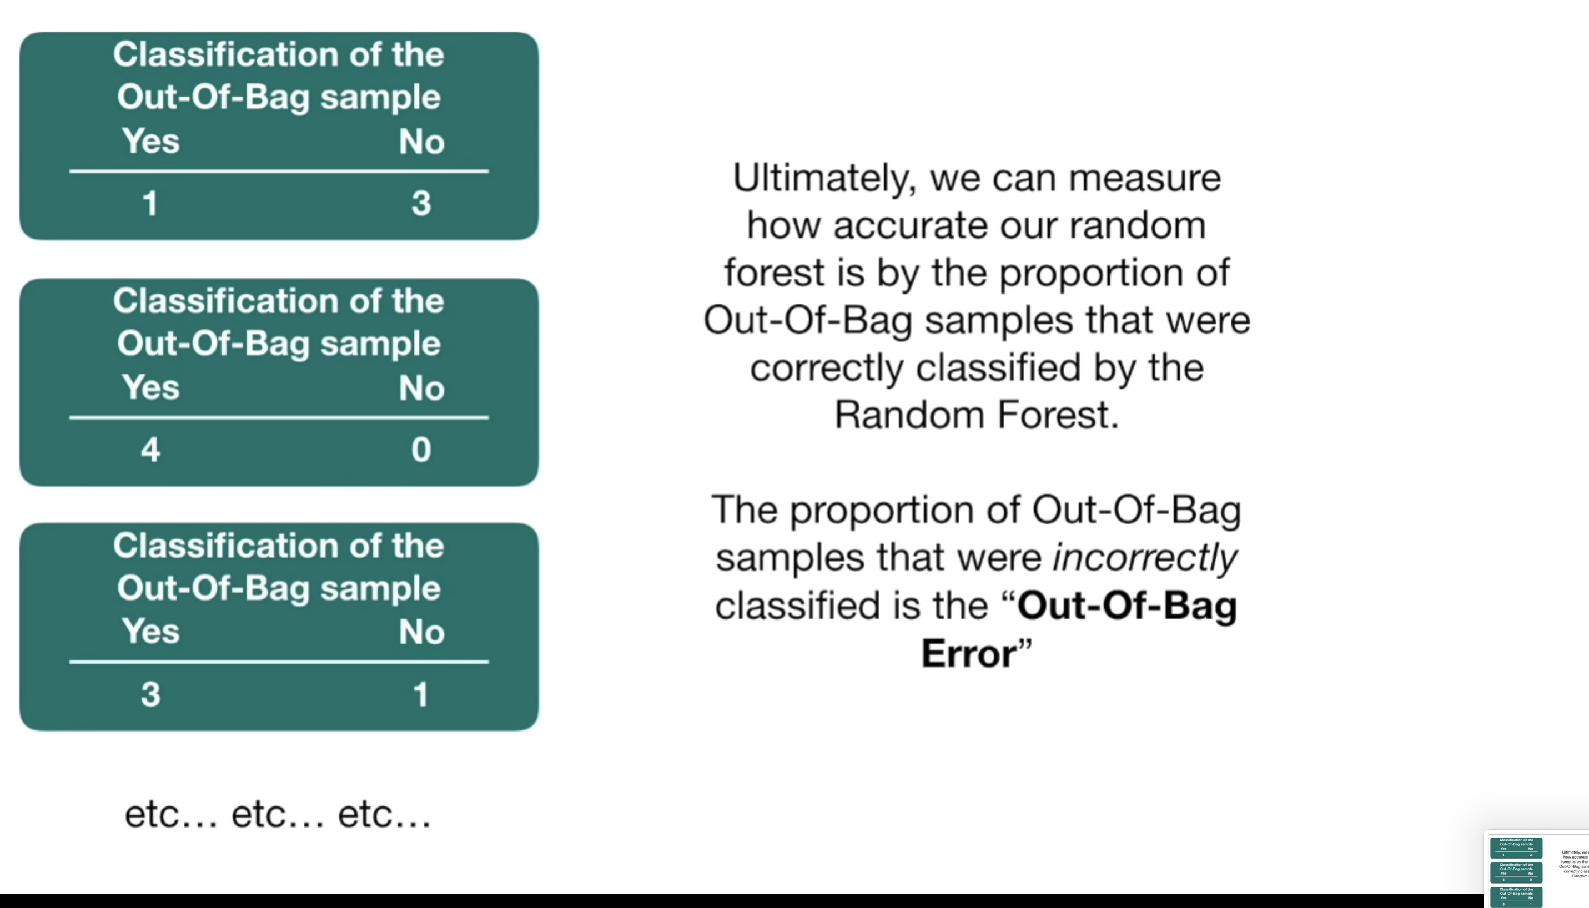

Slide 49
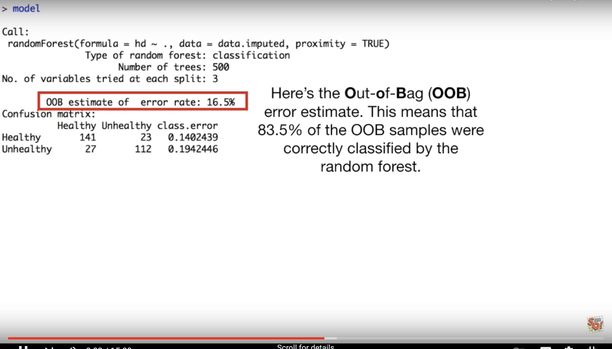

Slide 50
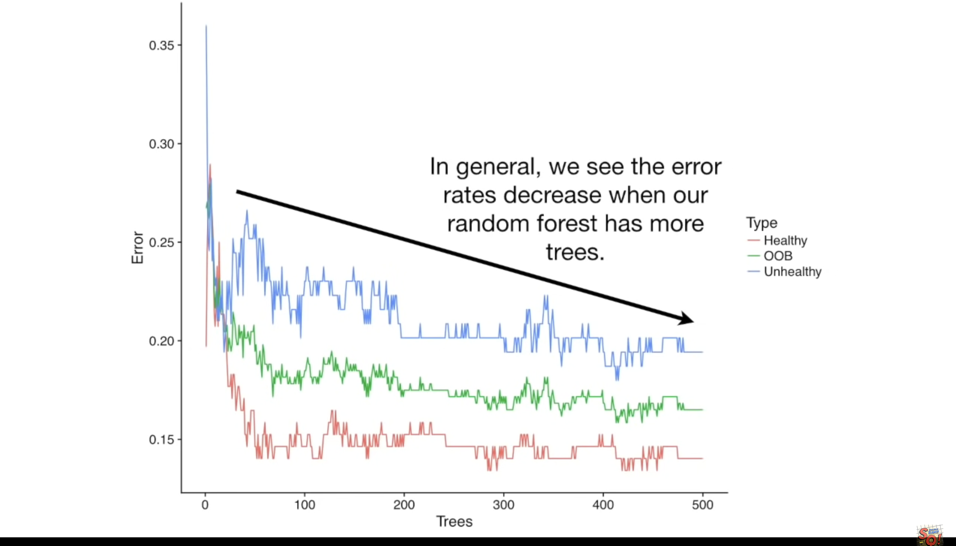

Slide 51
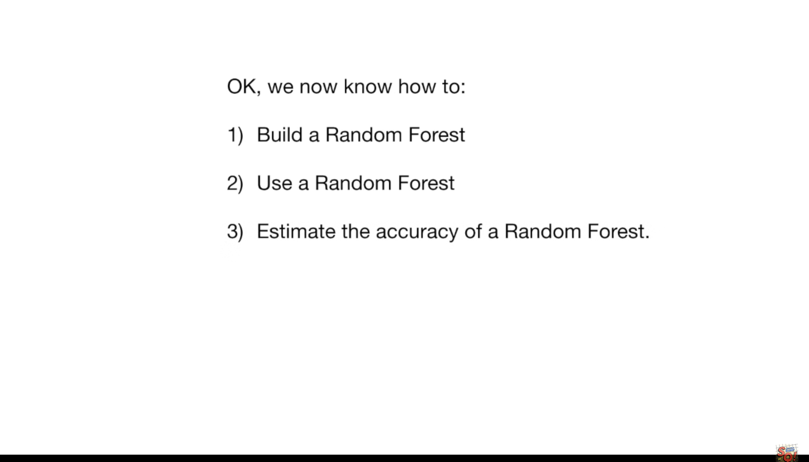

Slide 52
https://scikit-learn.org/stable/modules/ensemble.html#forest

Slide 53
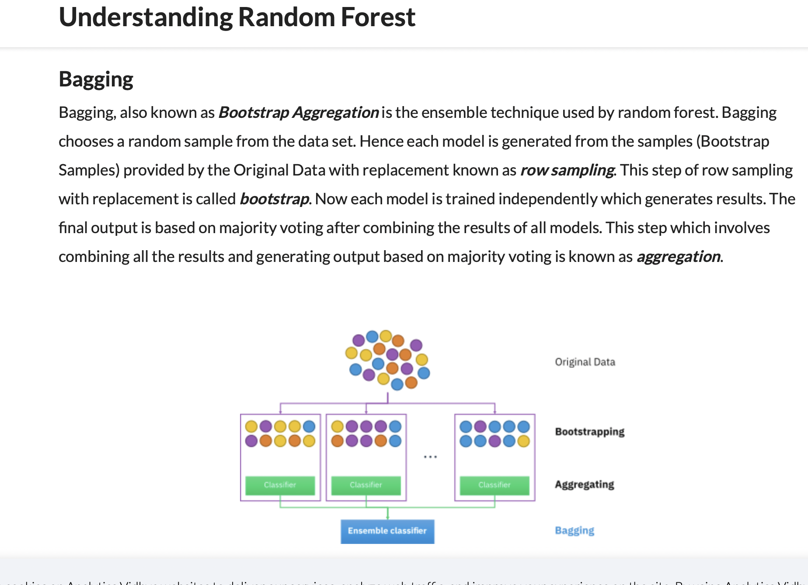
Notes:
https://www.section.io/engineering-education/introduction-to-random-forest-in-machine-learning/

Slide 54
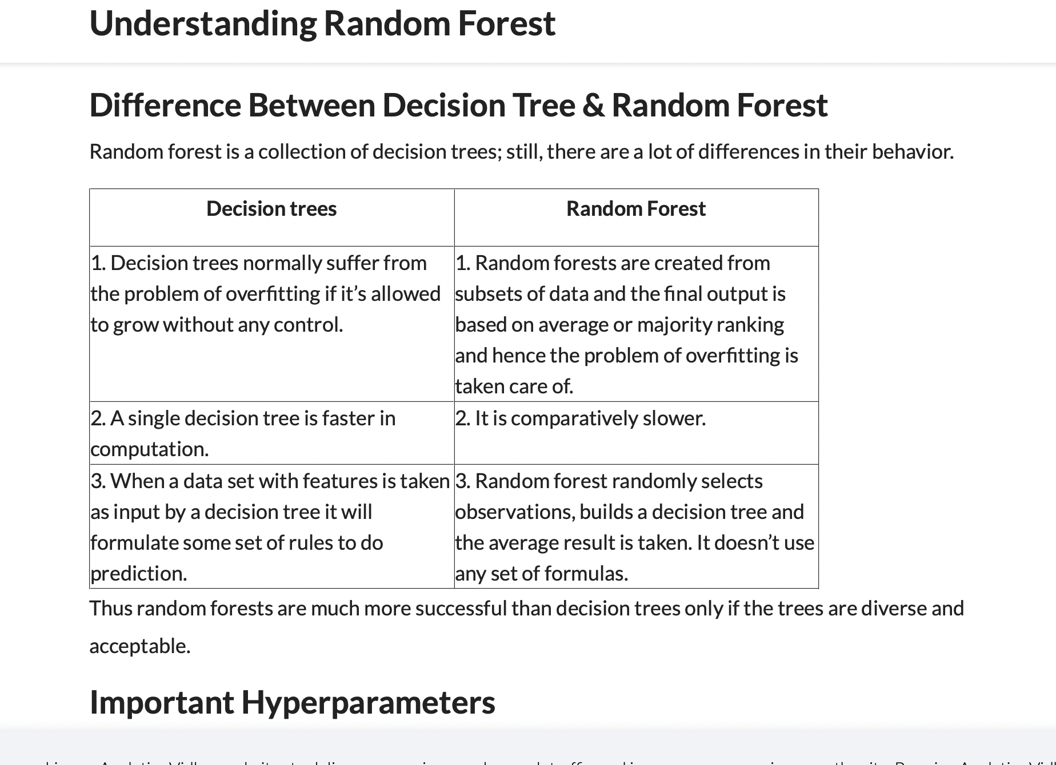
Notes:
https://www.analyticsvidhya.com/blog/2021/06/understanding-random-forest/

Slide 55
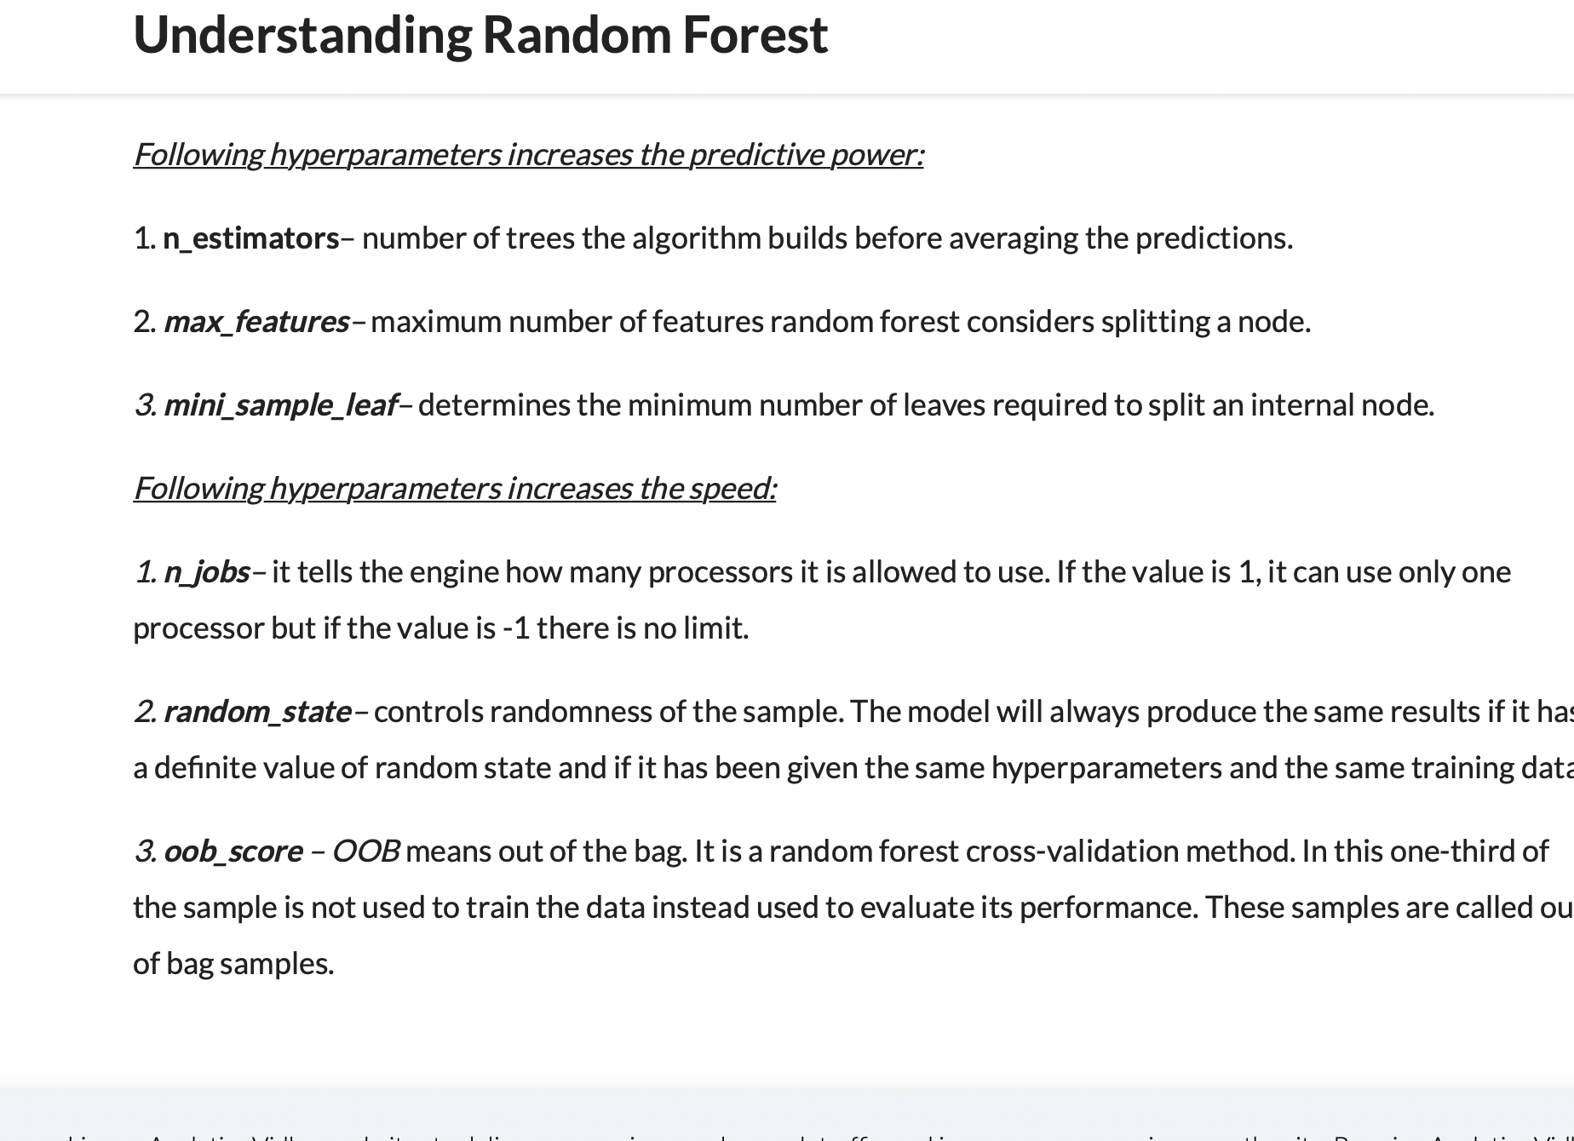

Slide 56
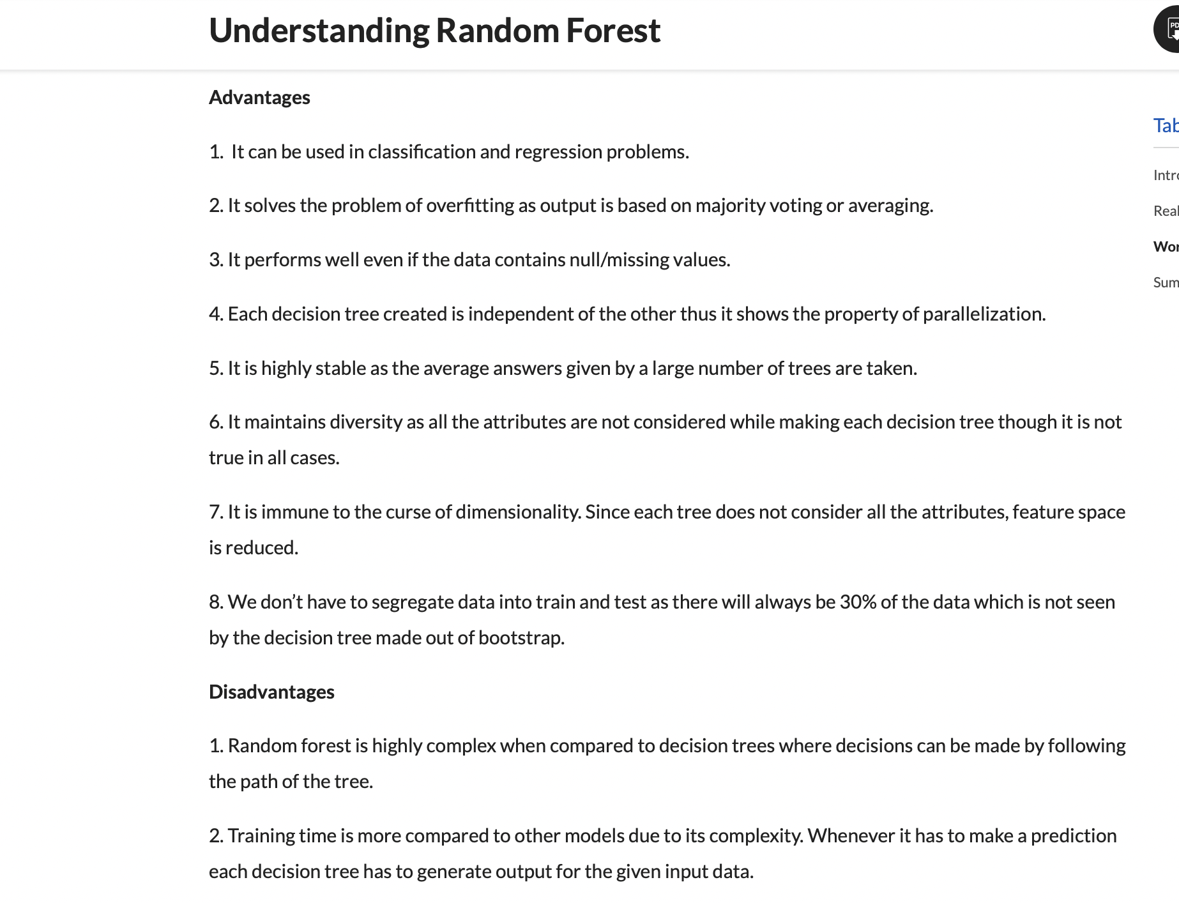

Slide 57
Boosting

Slide 58
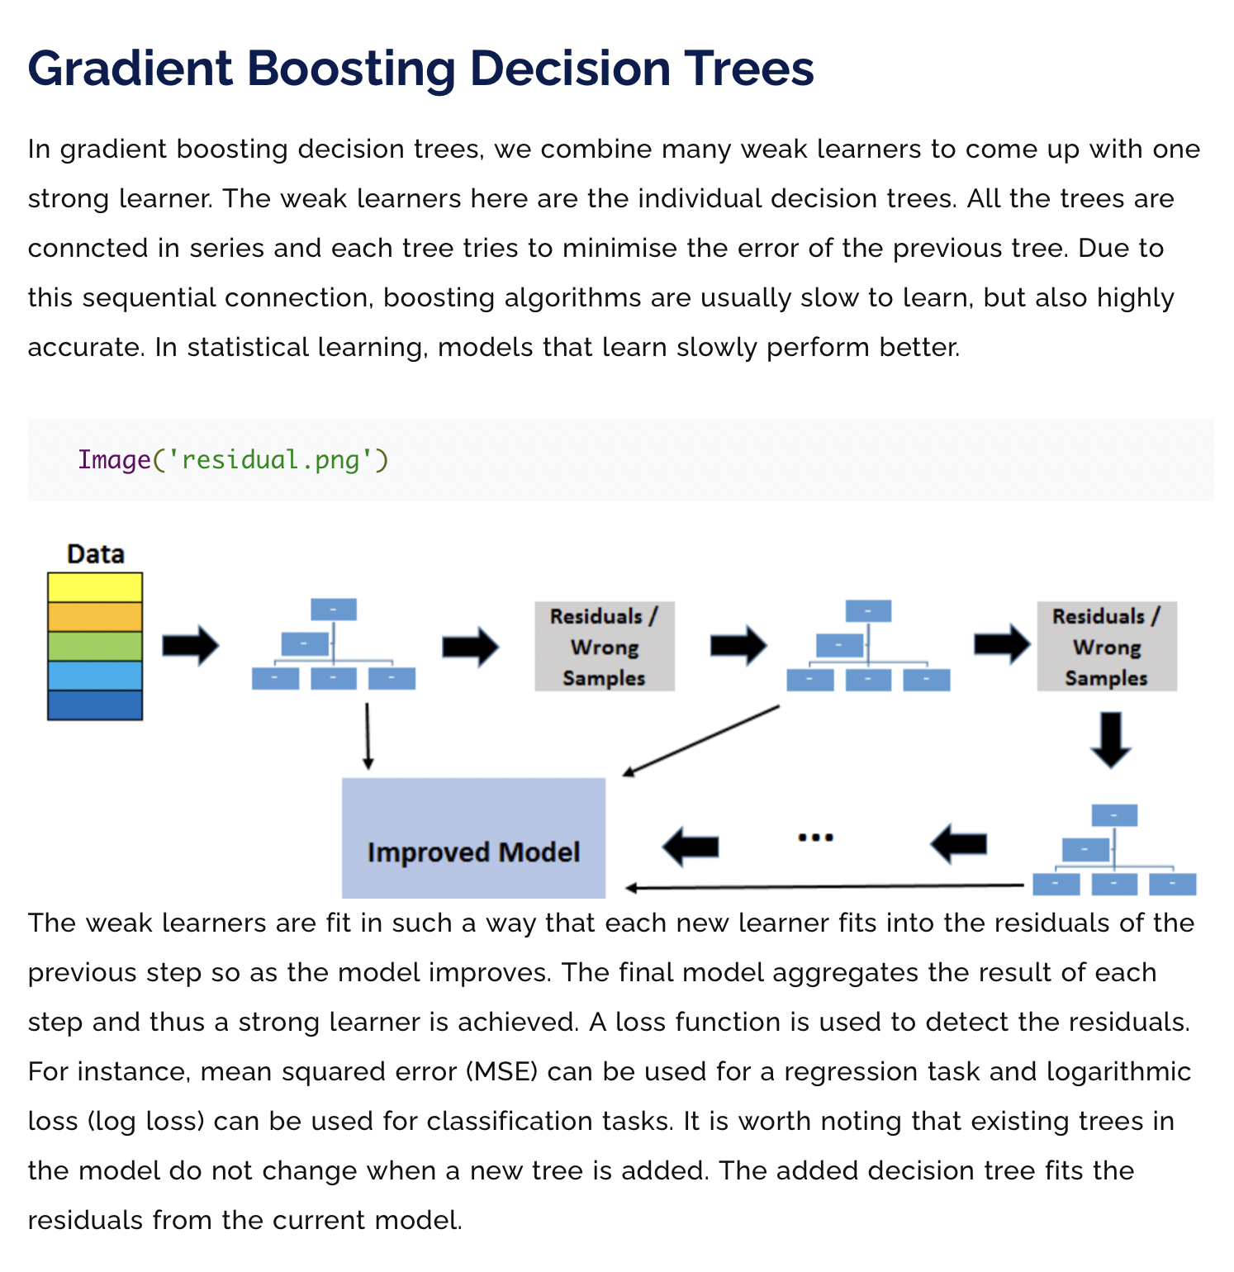
Notes:
https://www.machinelearningplus.com/machine-learning/an-introduction-to-gradient-boosting-decision-trees/

Slide 59
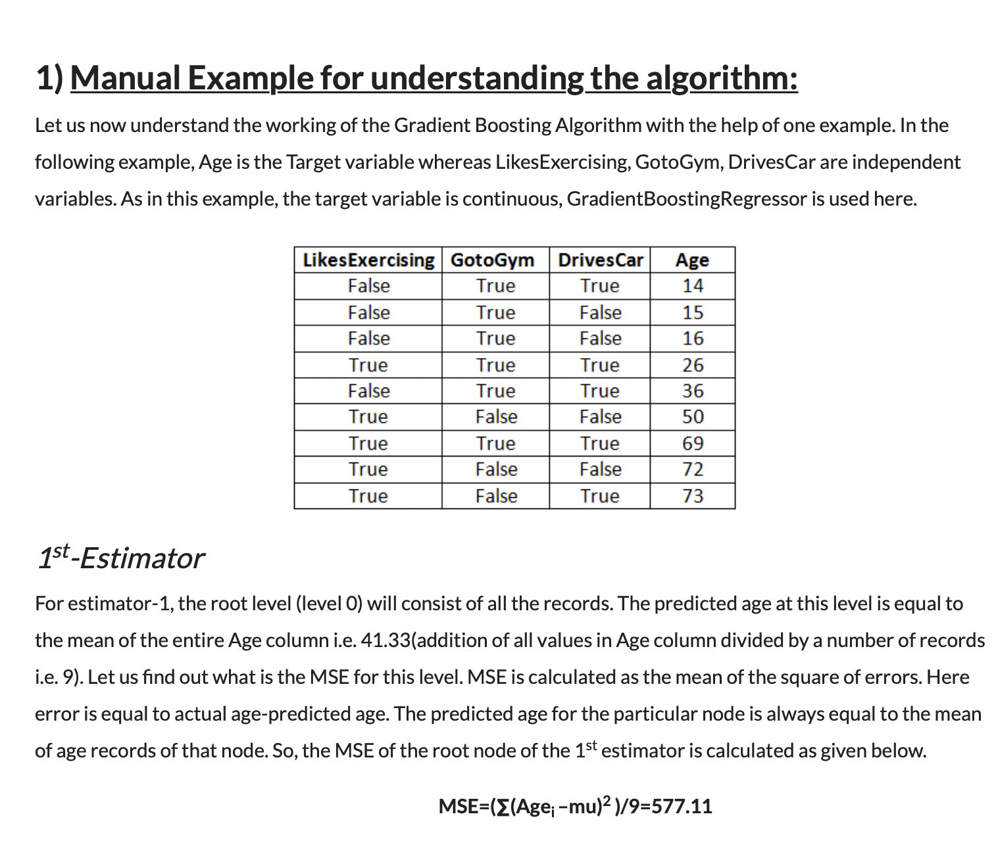
How the Gradient Boosting Algorithm works?
Notes:
https://www.analyticsvidhya.com/blog/2021/04/how-the-gradient-boosting-algorithm-works/

Slide 60


Slide 61


Slide 62


Slide 63


Slide 64


Slide 65


Slide 66


Slide 67


Slide 70
Evaluation and model selection

Slide 72


(Sensitivity)
Specificity= TN/(TN+FP)
Notes:
https://towardsdatascience.com/understanding-confusion-matrix-a9ad42dcfd62

Slide 73


Notes:
https://towardsdatascience.com/understanding-auc-roc-curve-68b2303cc9c5

Slide 74


Notes:
https://machinelearningmastery.com/fbeta-measure-for-machine-learning/
https://medium.com/@douglaspsteen/beyond-the-f-1-score-a-look-at-the-f-beta-score-3743ac2ef6e3

Slide 77


Slide 78


Slide 79


Slide 80








